Slide 1

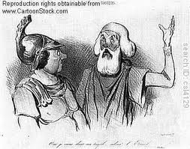
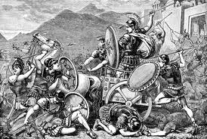
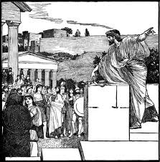
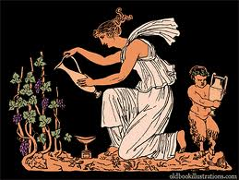
How Ancient Greece Influenced Western Civilization and The United States Government.

Slide 2
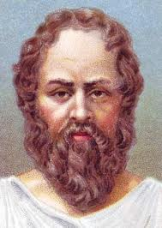
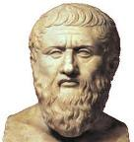
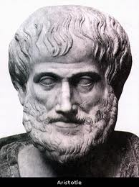
We can trace Western Philosophy to three main philosophers from Ancient Greece.
SOCRATES
PLATO
ARISTOTLE

Slide 3
Socrates and Plato believed that all knowledge is inborn.
Your destiny is fixed at birth
Aristotle believed that you become the person you are through learning and experience.
You have free will
SOCRATES
PLATO
ARISTOTLE

Slide 4
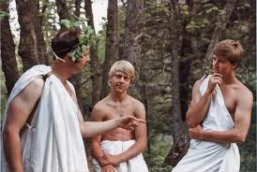
In a famous experiment, Socrates proved that all knowledge is inborn by getting an uneducated slave boy to solve a geometric problem.
He did this by asking the boy a series of leading questions until he was able to solve the problem. Socrates believed that this proved that the slave boy was born with the knowledge of geometry.

Slide 5
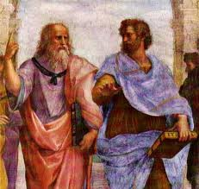
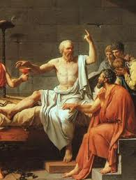
Socrates was a philosopher/teacher who walked the streets of Athens discussing philosophy with the young people of the city.
The leaders of Athens eventually put him to death because he was corrupting the morals of the young people.
He was forced to drink hemlock and continued to talk on his death bed until his life was over

Slide 6
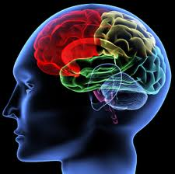
Plato believed that you are born with all of the knowledge of the world already inside your brain. All you have to do is get the knowledge out of your brain
Who you are is determined at birth.

Slide 7

PLATO’S REPUBLIC
This is how Plato thought society should be organized
Everyone is born to do a certain job
You cannot change what you were born to do
If you do the job you were born to do you will be happy
Everyone has a place in society.
You cannot move up or down in society
Society is more important than any one individual
You were born to serve society
PLATO’S REPUBLIC

Slide 8
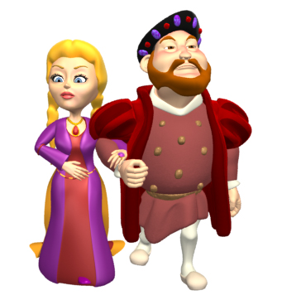
The king or queen is born with gold in their veins. They are the smartest people in society. The king was born to be king
PLATO’S REPUBLIC

Slide 9


The king or queen is born with gold in their veins. They are the smartest people in society
PLATO’S REPUBLIC
Soldiers and police were born with silver in their veins.

Slide 10
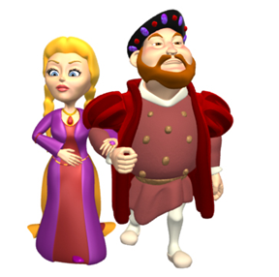


The king or queen is born with gold in their veins. They are the smartest people in society
PLATO’S REPUBLIC
Soldiers and police were born with silver in their veins.
Everyone else is born with copper in their veins

Slide 11


At birth everyone is assigned a place in Plato’s Republic
By serving the state you are serving the people in the state

Slide 12
SUMMARY OR PLATOS’ REPUBLIC
One job for life (guaranteed)
Remain in the class society assigns to you
Eternal bonding is forbidden
Children taken from mothers and raised by society
Equality for men and women
Mating lotterys to conceive new babies
All art must support the state
Music – painting – literature – TV – etc
The state is more important than the individual

Slide 13
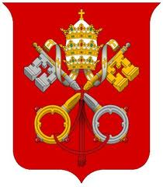
The Middle Ages Catholic Church adopted Plato’s model
GOD
Angels
Pope
Cardinals, etc
The world view of the church.
THE KING
The Nobility
Lawyers, Doctors, etc.
Carpenters, Blacksmiths, etc
Women
Mammals
Fish
Insects

Slide 14
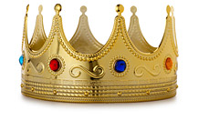
The King was King because God made him the king.
GOD
Angels
The Divine Right of Kings
Pope
Cardinals, etc
THE KING
The Nobility
Lawyers, Doctors, etc.
Carpenters, Blacksmiths, etc
Women
Mammals
Fish
Insects

Slide 15
DICTATOR
CHIEF
KING
NAZIS
SOCIALISTS
ISLAM NATIONS
COMMUNISTS
PARTY LEADERS
GOV. OFFICIALS
MILITARY
POLICE
THE PEOPLE

Slide 16
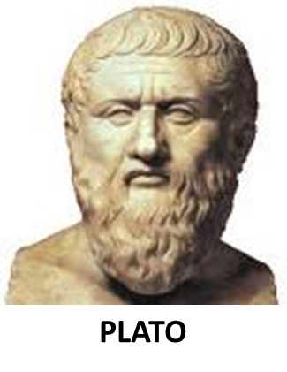
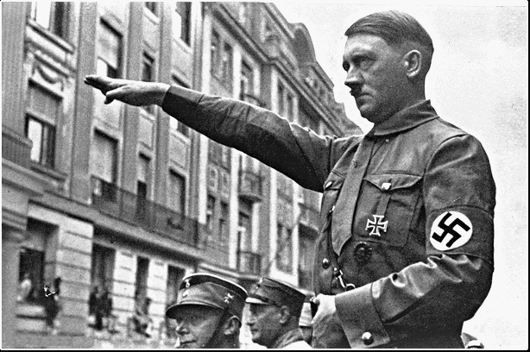

PLATO’S REPUBLIC
DIVINE RIGHT KINGS
MIDDLE AGES
DIVINE RIGHT OF KINGS
SOCIALISM TOTALITARIAN GOVERNMENTS

Slide 17
Socrates and Plato believed that all knowledge is inborn.
Your destiny is fixed at birth
Aristotle believed that you become the person you are through learning and experience.
You have free will
SOCRATES
PLATO
ARISTOTLE

Slide 18
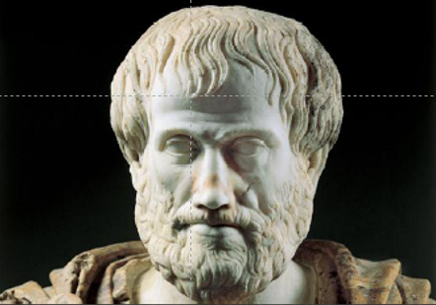

ARISTOTLE

Slide 19


Slide 20
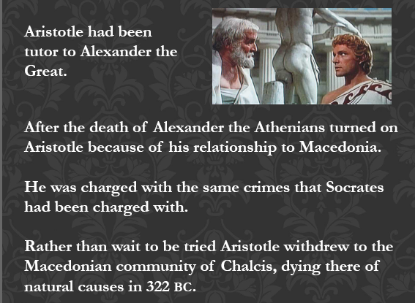

Slide 21

ARISTOTLE IDOLOGY VS PLATO’S REPUBLIC

Slide 22
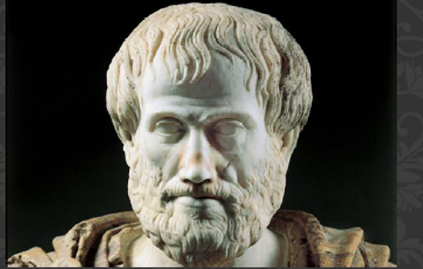
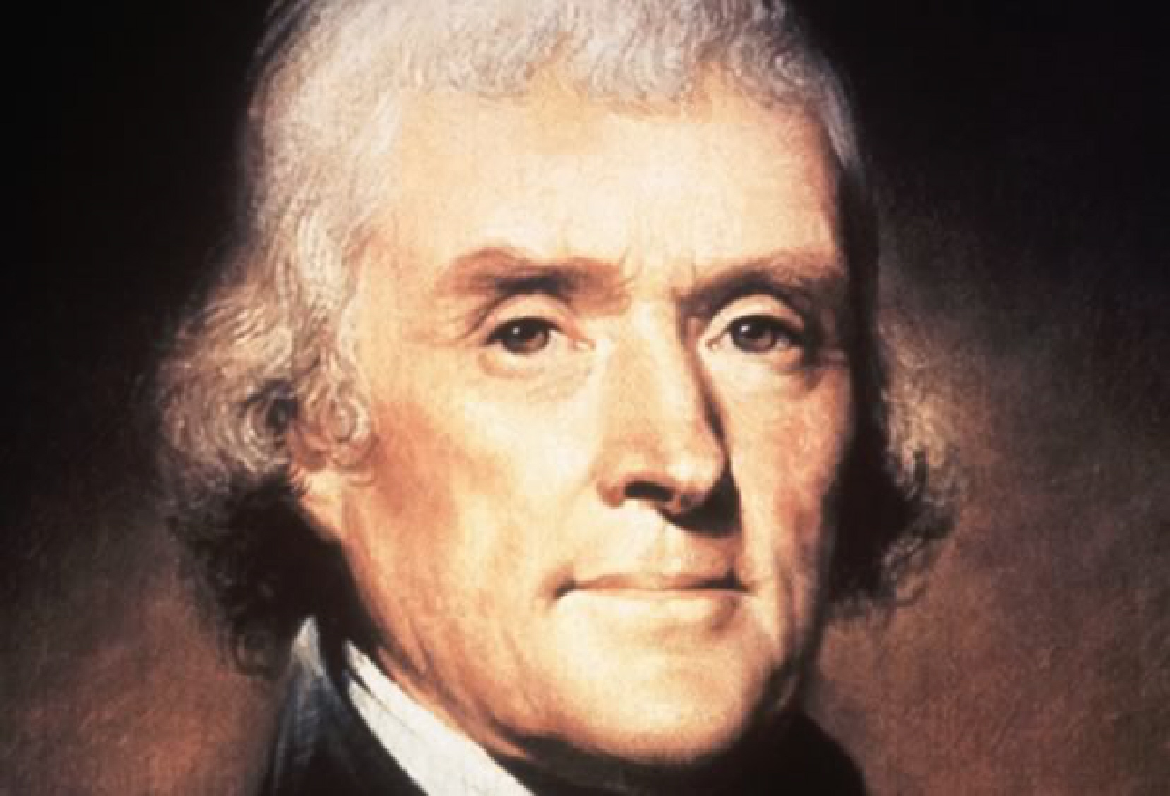
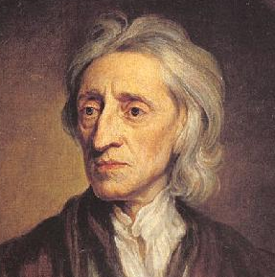
ARISTOTLE
RENAISSANCE
SCIENTIFIC REVOLUTION
ENLIGHTENMENT
JOHN LOCKE
DECLARATION OF INDEPENDENCE
THOMAS JEFFERSON
JOHN LOCKE

Slide 23
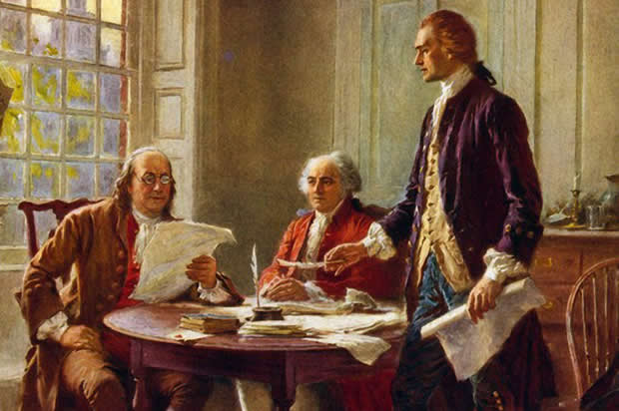
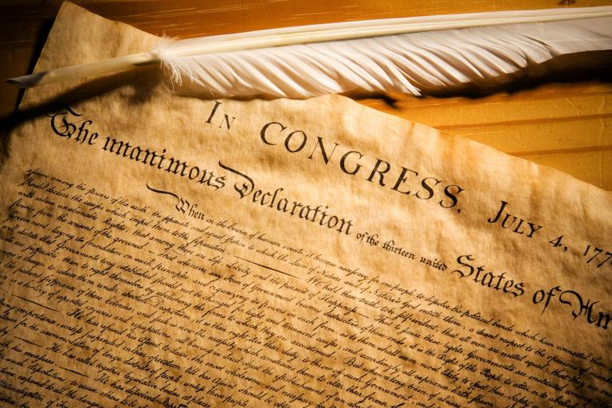
People are born with natural rights of:
Life
Liberty
Property
The purpose of government is to protect your natural rights.
The individual is more important than the state

Slide 24
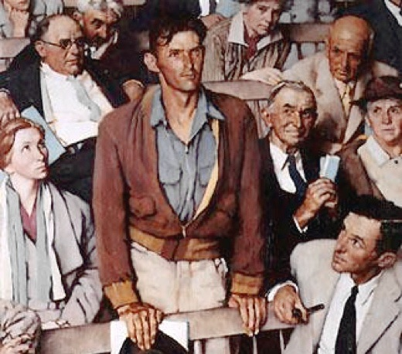
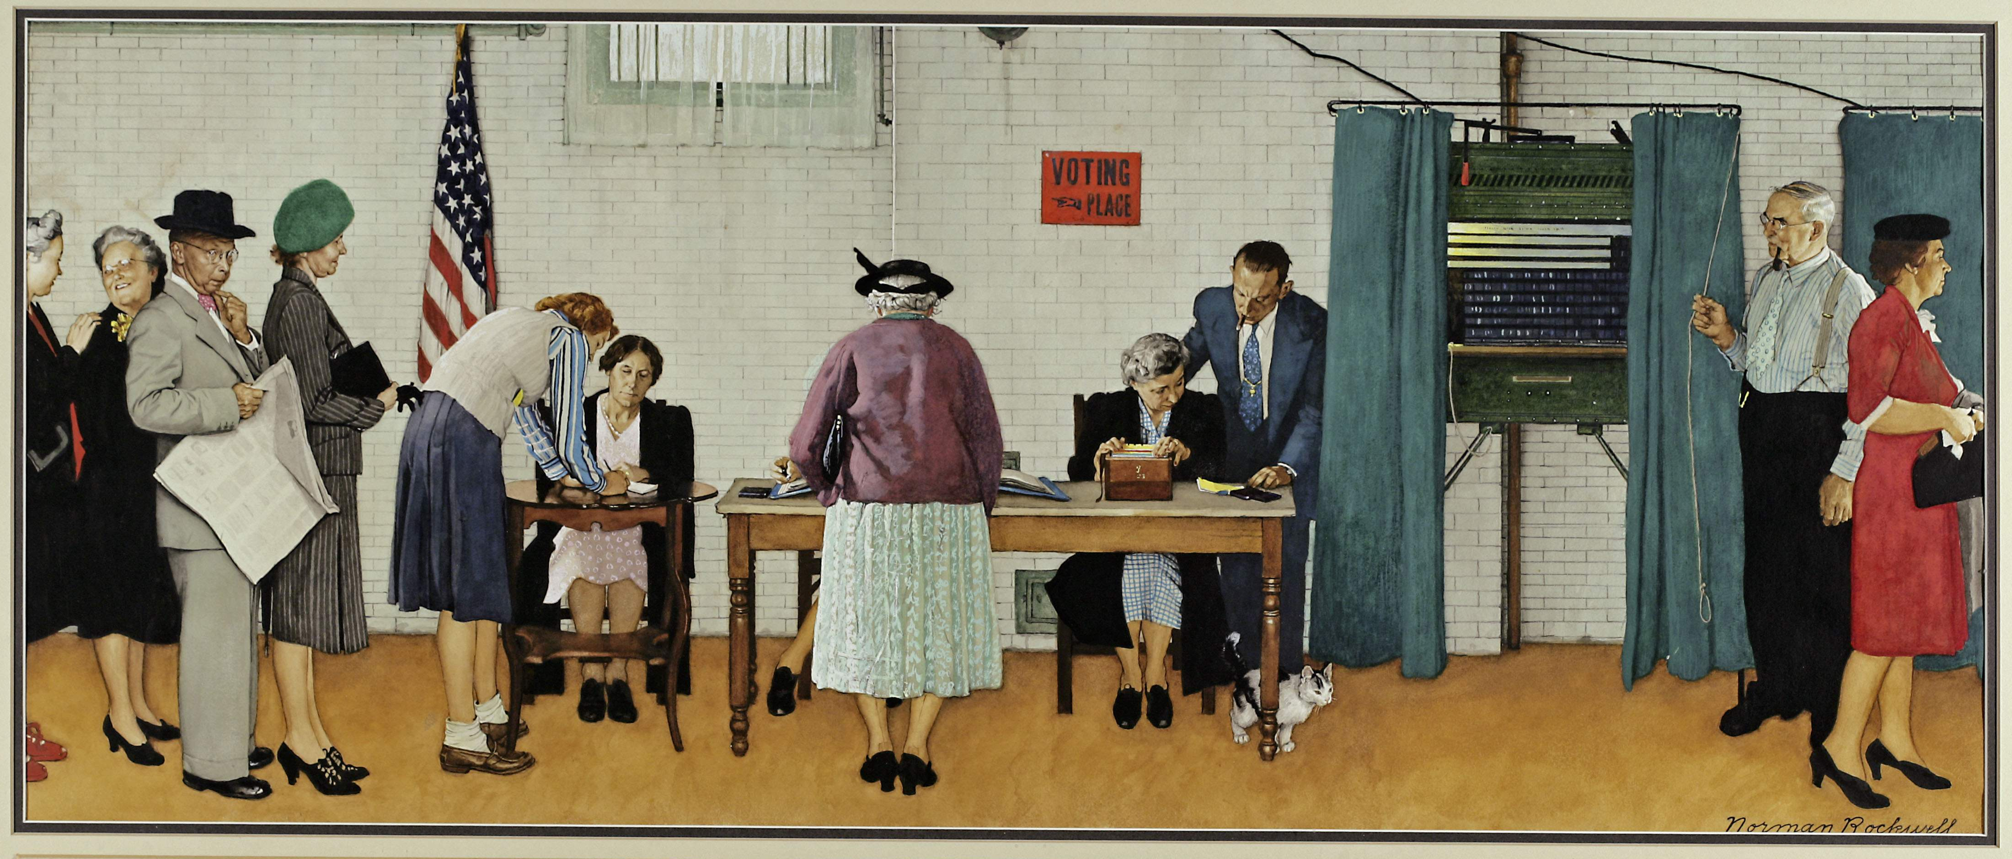
Ordinary people can rule themselves.
They do not need a king, a chief or a dictator!
The United States is the first country created on an idea…

Slide 25
Thank you for your attention

Slide 26
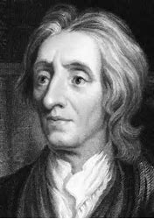
ARISTOTLE
MIDDLE AGES BLACK OUT
ARISTOTLE
RENAISSANCE
New Ideas
SCIENTIFIC REVOLUTION
ENLIGHTENMENT
JOHN LOCKE
JOHN LOCKE

