Slide 1

Magruder’s
American Government
C H A P T E R 10
Congress
© 2001 by Prentice Hall, Inc.

Slide 2

C H A P T E R 10
Congress
SECTION 1 The National Legislature
SECTION 2 The House of Representatives
SECTION 3 The Senate
SECTION 4 The Members of Congress
1
2
3
4
Chapter 10

Slide 3
S E C T I O N 1
The National Legislature
Why does the Constitution divide power between the two houses of Congress?
What is a term of Congress?
How have sessions of Congress changed over time?
2
3
4
Chapter 10 Section 1

Slide 4
Two Houses of Congress
The Constitution creates a bicameral legislature for three reasons:
  Historical: The British Parliament consisted of two houses since the 1300s, and many colonial assemblies were similar in form.
  Practical: A bicameral legislature was necessary to compromise the Virginia and New Jersey plans of representation.
  Theoretical: The Framers favored a bicameral Congress in order that one house might act as a check on the other.
2
3
4
Chapter 10, Section 1

Slide 5
Terms
A term is the length of time that officials serve after an election, as in a two- or six-year term.
The date for the start of each new term has been set by the Twentieth Amendment (1933) as “noon of the 3d day of January” of every odd-numbered year.
2
3
4
Chapter 10, Section 1

Slide 6
Sessions of Congress
A session is the regular period of time during which Congress conducts business.
Congress adjourns, or suspends until the next session, each regular session as it sees fit.
If necessary, the President has the power to prorogue, or adjourn, a session, but only when the two houses cannot agree on a date for adjournment.
Only the President may call Congress into a special session—a meeting to deal with some emergency situation.
2
3
4
Chapter 10, Section 1

Slide 7
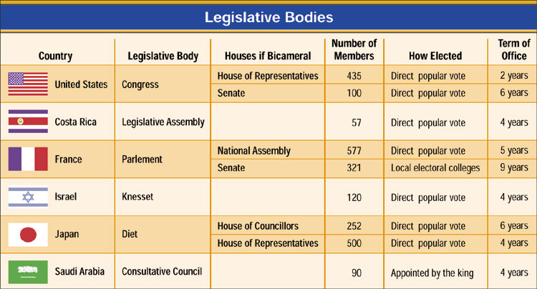
Comparative Government: Legislative Bodies
2
3
4
Chapter 10, Section 1

Slide 8
Section 1 Review
1. The practical reason behind establishing a bicameral legislature was
  (a) the necessity to find compromise between the New Jersey and Virginia plans.
  (b) the need to mimic existing British institutions.
  (c) a desire to break from all tradition.
  (d) requirements set by the British monarchy.
2. Special sessions of Congress
  (a) are called by the President to deal with some emergency situation.
  (b) are called whenever a senator filibusters.
  (c) are never called.
  (d) are used to handle the everyday business of Congress.
Want to connect to the Magruder’s link for this section? Click Here!
2
3
4
Chapter 10, Section 1

Slide 9
S E C T I O N 2
The House of Representatives
What are the size and terms of the House of Representatives?
How are House seats reapportioned among the States after each census?
How can we describe a typical congressional election and congressional district?
What are the formal and informal qualifications for serving in the House?
1
3
4
Chapter 10, Section 2

Slide 10
Size and Terms
The exact size of the House of Representatives, currently at 435 members, is determined by Congress.
The Constitution provides that the total number of seats in the House shall be apportioned (distributed) among the States on the basis of their respective populations.
Members of the House of Representatives serve two-year terms.
Although there have been recent movements to limit terms, there are no limits set on the number of terms a representative may serve.
1
3
4
Chapter 10, Section 2

Slide 11
Reapportionment
Article I of the Constitution directs Congress to reapportion—redistribute—the seats in the House after each decennial census.
As the United States grew in population, the number of representatives in the House also grew.
The Reapportionment Act of 1929 set the “permanent” size of the House at 435 members, and provided for “automatic reapportionment.”
1
3
4
Chapter 10, Section 2

Slide 12
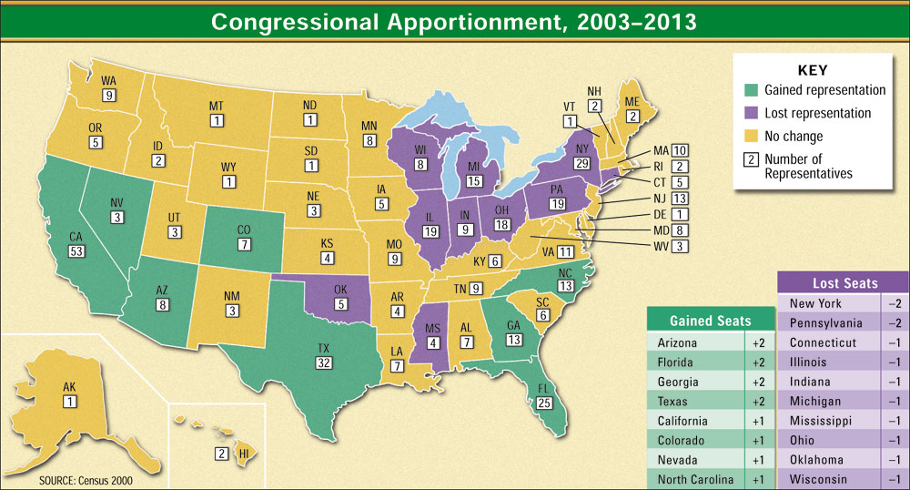
Current Apportionment
1
3
4
Chapter 10, Section 2

Slide 13
Congressional Elections
Congressional elections are held on the Tuesday following the first Monday in November of each even-numbered year.
Off-year elections are those congressional elections held between presidential elections.
1
3
4
Chapter 10, Section 2

Slide 14
Districts and Gerrymandering
Under the single-member district arrangement, the voter’s in each district elect one of the State’s representatives.
The general-ticket system, no longer in use, provided that all of a State’s seats were filled at-large.
Districts that have unusual shapes or even defy description have sometimes been gerrymandered.
Gerrymandering refers to the act of drawing congressional districts to the advantage of the political party that controls the State legislature.
1
3
4
Chapter 10, Section 2

Slide 15


53rd Congressional District – Susan Davis

Slide 16

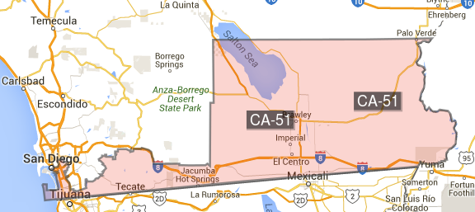
51st Congressional District – Juan Vargas

Slide 17
Qualifications for House Members
The Constitution says that a member of the House
  (1) must be at least 25 years of age,
  (2) must have been a citizen of the United States for at least seven years, and
  (3) must have been an inhabitant of the State from which he or she is elected.
The realities of politics also require some informal qualifications, such as party identification, name familiarity, gender, ethnic characteristics, and political experience.
1
3
4
Chapter 10, Section 2

Slide 18
Section 2 Review
1. Members of the House of Representatives are elected for
  (a) two-year terms.
  (b) six-year terms.
  (c) four-year terms.
  (d) five-year terms.
2. The Constitution requires a member of Congress to be
  (a) an inhabitant of the State from which he or she is elected.
  (b) a property-owning male.
  (c) a natural-born citizen.
  (d) at least 40 years of age.
Want to connect to the Magruder’s link for this section? Click Here!
1
3
4
Chapter 10, Section 2

Slide 19
S E C T I O N 3
The Senate
How does the size of the Senate differ from the size of the House?
How have States elected senators in the past and present?
How and why does a senator’s term differ from a representative’s term?
What are the qualifications for serving in the Senate?
1
2
4
Chapter 10, Section 3

Slide 20


California U.S. Senators - Democrats
Barbara Boxer
Diane Feinstein

Slide 21
Size, Election, and Terms
The Constitution says that the Senate “shall be composed of two Senators from each State.” Today’s Senate consists of 100 Senators.
Originally, the Constitution provided that senators were chosen by the State legislatures.
In 1912 the Seventeenth Amendment was passed and called for the popular election of senators.
Senators serve for six-year terms.
The Senate is a continuous body, meaning that all of its seats are never up for election at the same time.
1
2
4
Chapter 10, Section 3

Slide 22
Qualifications for Senators
The requirements for the U.S. Senate are higher than for the House of Representatives.
The Constitution says that a Senator
  (1) must be at least 30 years of age,
  (2) must have been a citizen of the United States for at least nine years, and
  (3) must be an inhabitant of the State from which he or she is elected.
1
2
4
5
Chapter 10, Section 3

Slide 23
Section 3 Review
1. Senators are elected for
  (a) two-year terms.
  (b) eight-year terms.
  (c) four-year terms.
  (d) six-year terms.
2. The Senate is a continuous body, meaning that
  (a) Senators must continually reside in Washington, D.C.
  (b) all of its seats are always up for election every six years.
  (c) it never adjourns.
  (d) all of its seats are never up for election at one time.
Want to connect to the Magruder’s link for this section? Click Here!
1
2
4
Chapter 10, Section 3

Slide 24
S E C T I O N 4
The Members of 114th Congress
What are the personal and political backgrounds of the current members of Congress?
What are the duties of the job of serving in Congress?
How are members of Congress compensated, and what privileges do they have?
1
2
3
Chapter 10, Section 4

Slide 25
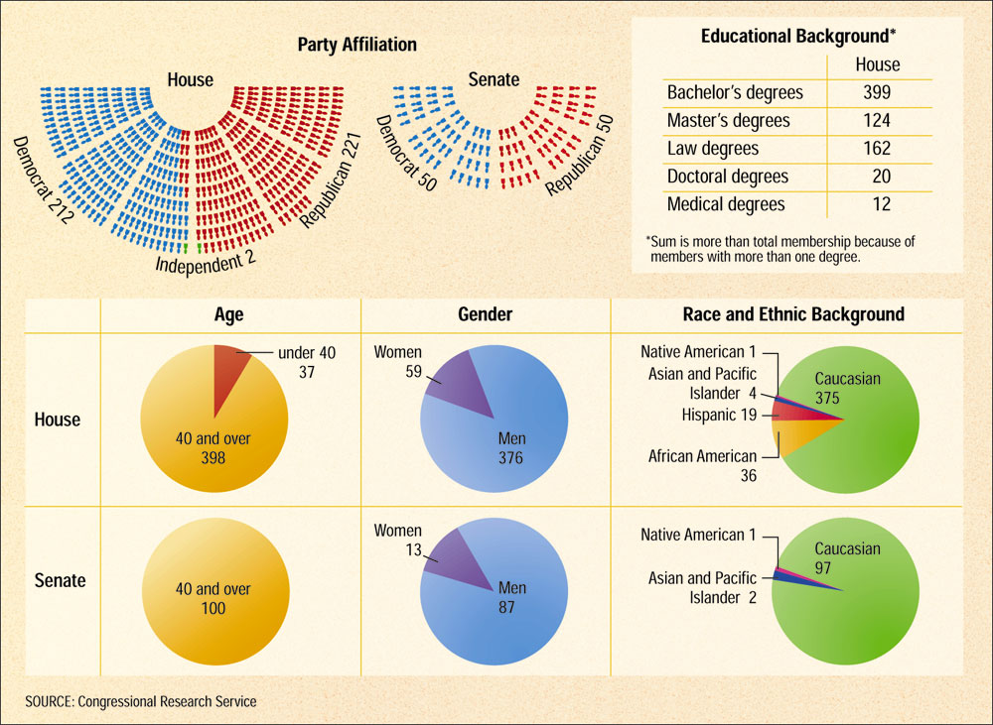
Profile of the 107th Congress
1
2
3
Chapter 10, Section 4

Slide 26
Representatives of the People
Senators and representatives are elected to represent people. As legislators, they have four voting options:
1
2
3
Chapter 10, Section 4

Slide 27
Committee Membership and Public Servants
As committee members, senators and representatives screen proposed laws before they are voted on.
Another vital part of their committee work involves the oversight function.
Oversight is the the process by which Congress, through its committees, checks to see that the agencies of the executive branch are working effectively.
Members of the House and the Senate also act as servants of their constituents.
Requests from voters vary widely, and members of Congress take heed to many of them. Ignoring their constituencies would not bode well in the next election.
1
2
3
Chapter 10, Section 4

Slide 28
Compensation
Today, senators and representatives are paid a salary of $141,300 a year. Certain members, such as the Speaker of the House and the Senate’s president pro tem, are paid more.
The franking privilege allows members of Congress to mail letters and other materials postage-free by substituting their facsimile signature (frank) for the postage.
The Constitution says that Congress fixes its own “compensation.” Therefore, the only real limits to congressional pay are the President’s veto and fear of voter backlash against a pay increase.
1
2
3
Chapter 10, Section 4

Slide 29
Membership Privileges
Members of Congress are immune from arrest for noncriminal offenses while engaged in congressional business.
More importantly, the Speech and Debate Clause (Article I, Section 6, Clause 1) protects representatives and senators from suits for libel or slander arising from their official conduct.
1
2
3
Chapter 10, Section 4

Slide 30
Section 4 Review
1. Which of the following is a major role of members of Congress?
  (a) law enforcement
  (b) servant of their constituents
  (c) serving in the military
  (d) researching court cases
2. The franking privilege allows members of Congress to
  (a) purchase as many hot dogs as necessary while in office.
  (b) mail letters and other materials postage-free.
  (c) vote on legislation.
  (d) receive a pension upon retirement from Congress.
Want to connect to the Magruder’s link for this section? Click Here!
1
2
3
Chapter 10, Section 4

