Slide 1
UNIT 4
ETHERNET PRINCIPLES

Slide 2
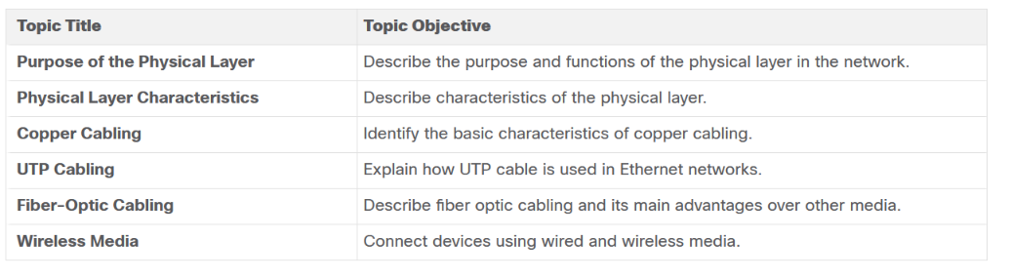
4.1 PHYSICAL LAYER

Slide 3
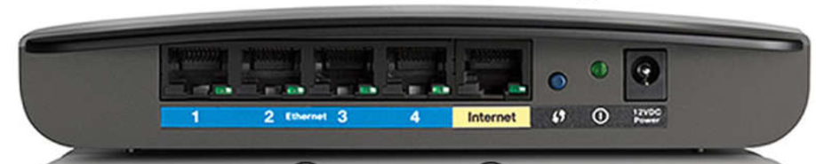
PERSONAL MODEM

Slide 4
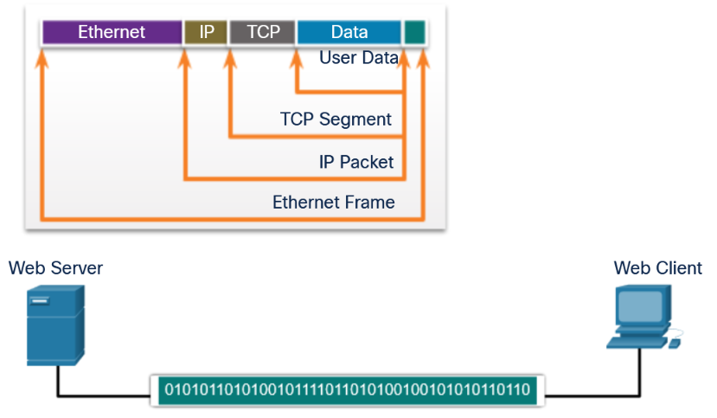

ETHERNET
FRAME

Slide 5
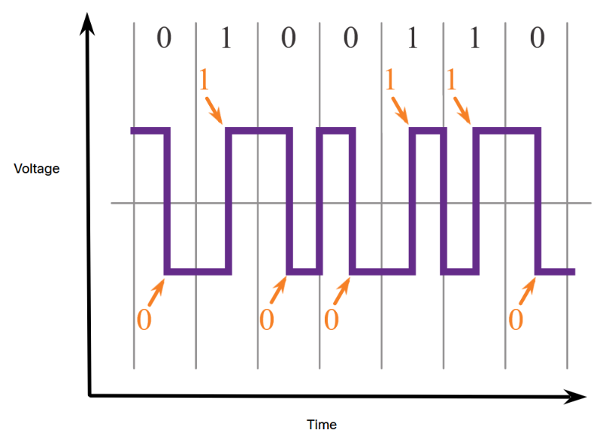
Manchester encoding is used in older Ethernet standards such as 10BASE-T. Ethernet 100BASE-TX uses 4B/5B encoding and 1000BASE-T uses 8B/10B encoding

Slide 6
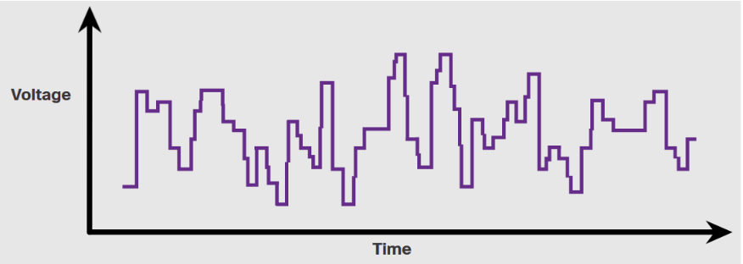
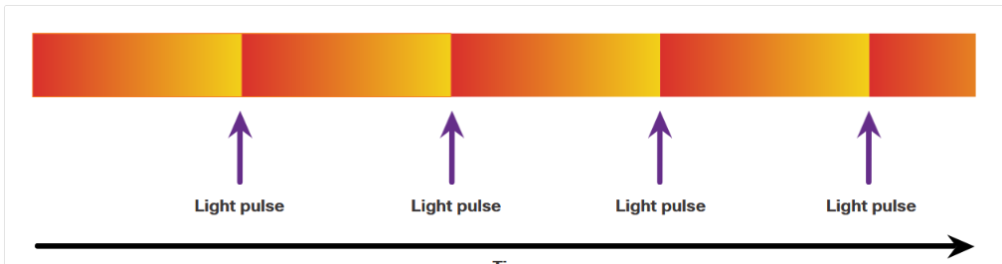
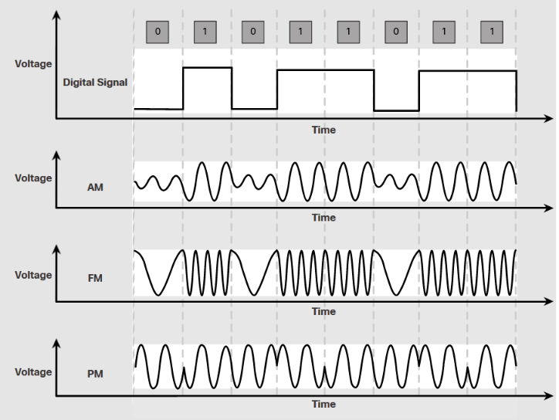
ELECTRICAL SIGNALS
DIGITAL
FIBER
MICROWAVE

Slide 7
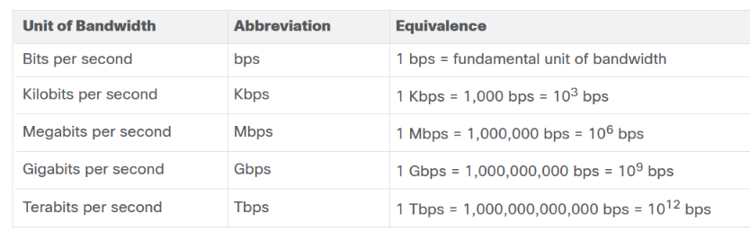
Latency Latency refers to the amount of time, including delays, for data to travel from one given point to another.
Throughput is the measure of the transfer of bits across the media over a given period of time
Goodput is throughput minus traffic overhead for establishing sessions, acknowledgments, encapsulation, and retransmitted bits. Goodput is always lower than throughput, which is generally lower than the bandwidth.

Slide 8
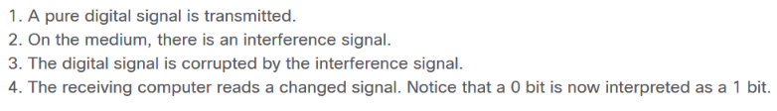
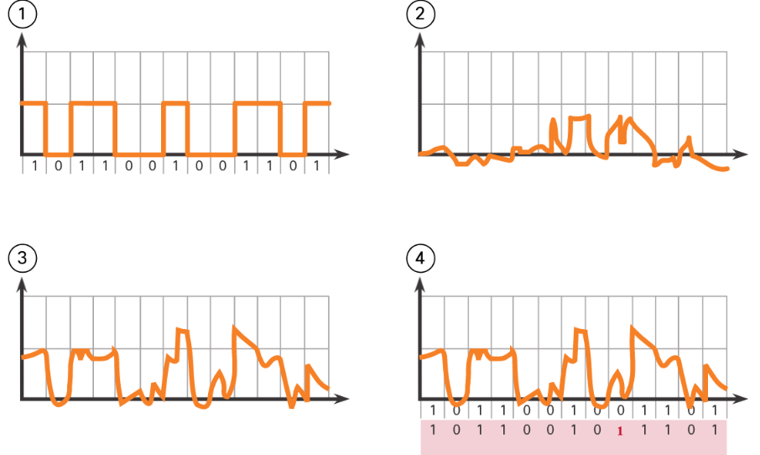
COPER CABLING

Slide 9
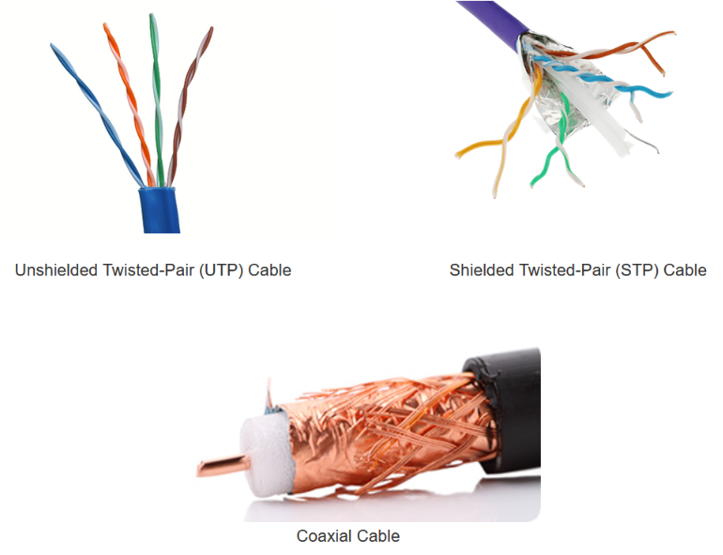
TYPES OF COPPER CABLING

Slide 10

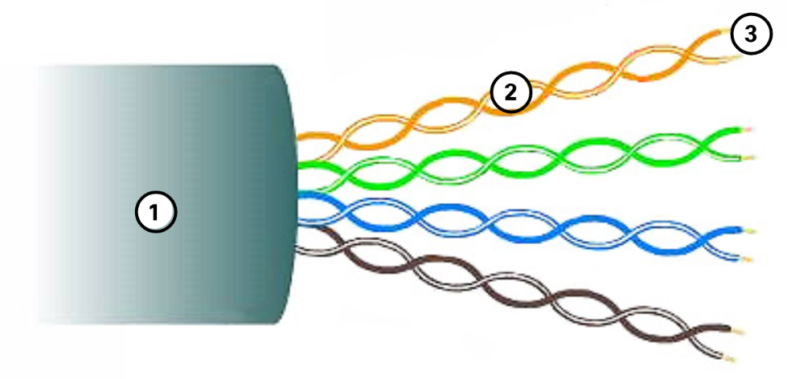

Slide 11
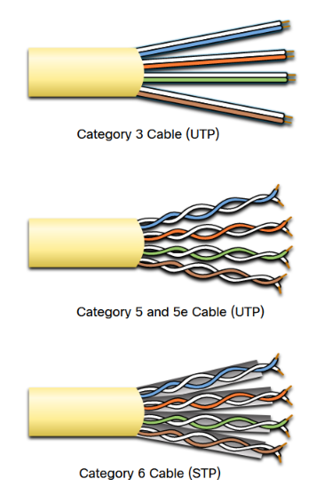
CABLE CATAGORIES
Category 3 was originally used for voice communication over voice lines, but later used for data transmission.
Category 5 and 5e is used for data transmission. Category 5 supports 100Mbps and Category 5e supports 1000 Mbps
Category 6 has an added separator between each wire pair to support higher speeds. Category 6 supports up to 10 Gbps.
Category 7 also supports 10 Gbps.
Category 8 supports 40 Gbps.

Slide 12
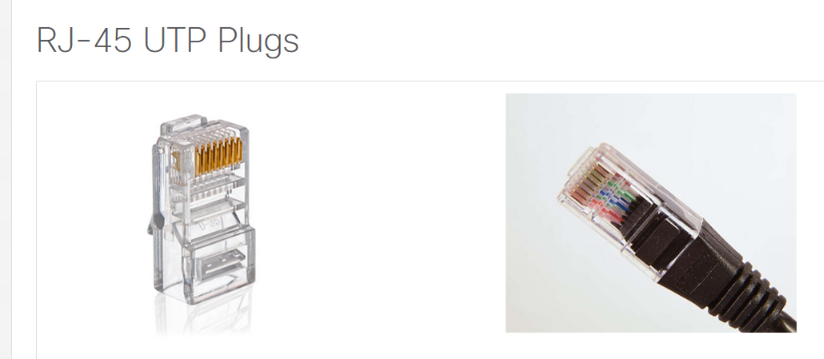
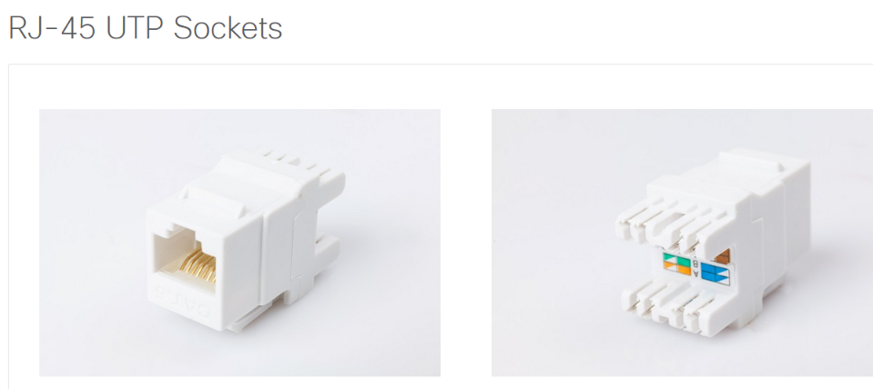

Slide 13
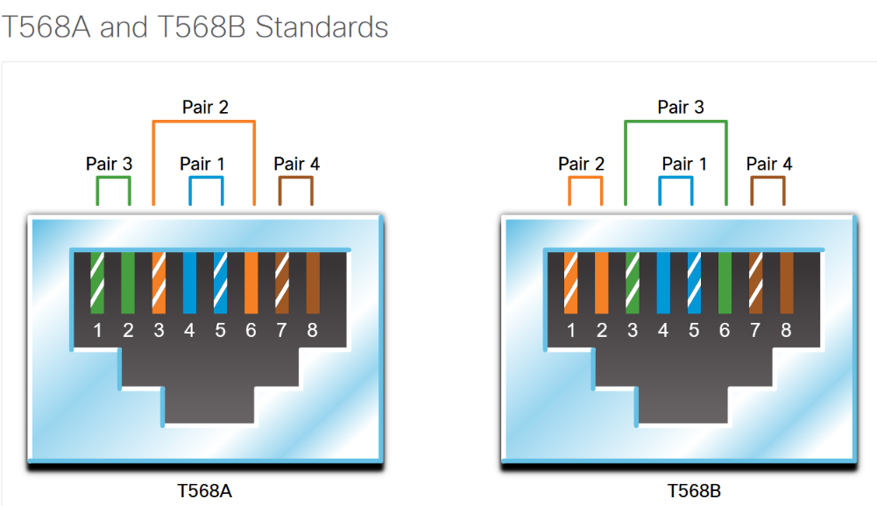
MAY NEED A CROSSOVER CABLE
TX
RX

Slide 14
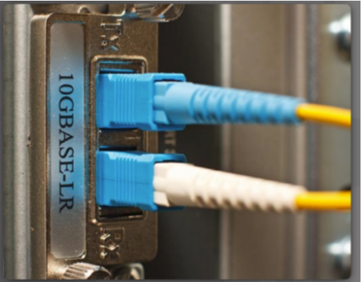
IN FIBER OPTIC CABLES YOU ALWAYS HAVE TWO WIRES.
ONE FOR DRANSMITTING
ONE FOR RECEIVING
TYPES OF PLUGS MAY VARY

Slide 15
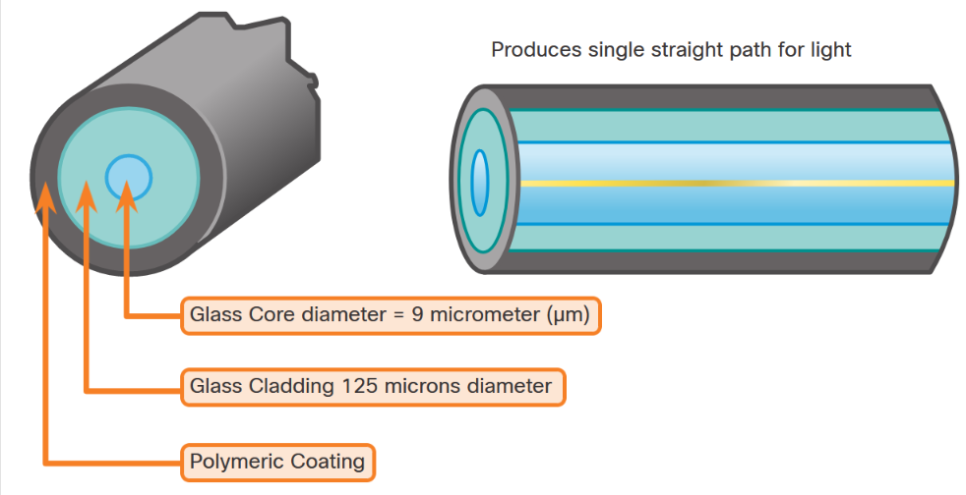
Single-Mode Fiber
SMF consists of a very small core and uses expensive laser technology to send a single ray of light, as shown in the figure. SMF is popular in long-distance situations spanning hundreds of kilometers, such as those required in long haul telephony and cable TV applications.
MUST USE A LASER LIGHT TO TRANSMIT

Slide 16
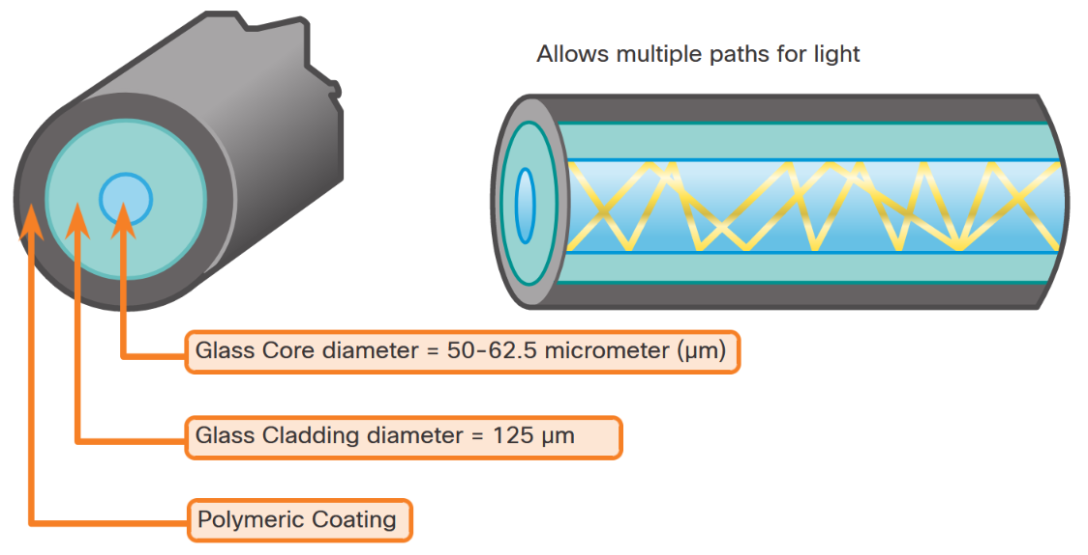
Multimode Fiber
MMF consists of a larger core and uses LED emitters to send light pulses. Specifically, light from an LED enters the multimode fiber at different, as shown in the figure. MMFs are popular in LANs because they can be powered by low-cost LEDs. It panglesrovides bandwidth up to 10 Gbps over link lengths of up to 550 meters

Slide 17
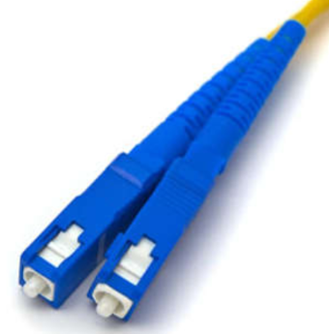

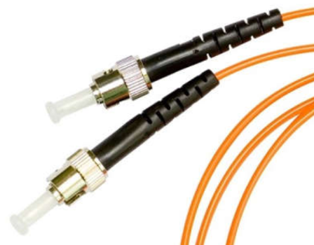
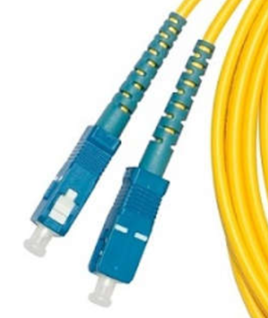
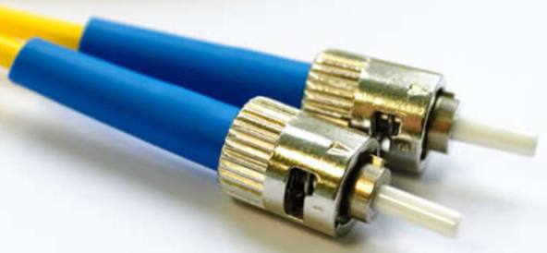

Slide 18
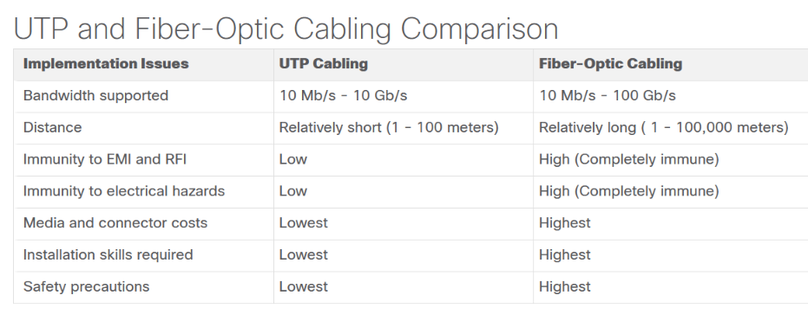

Slide 19
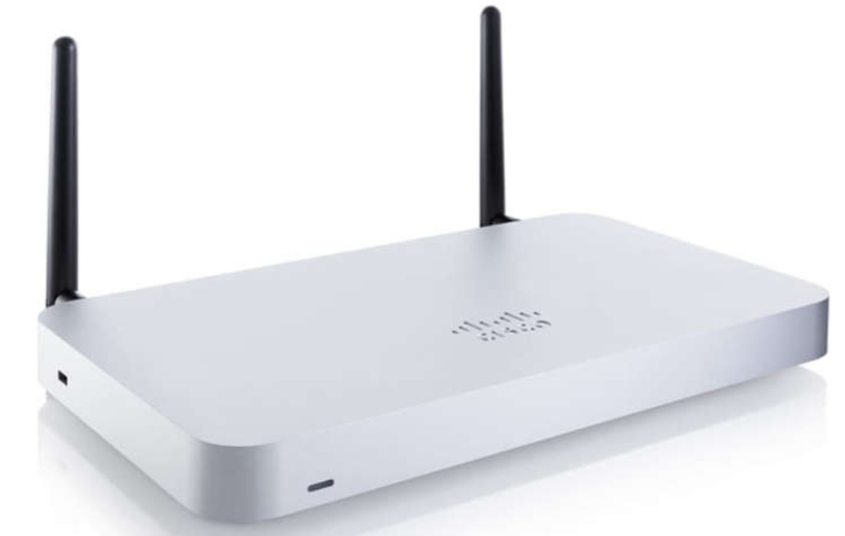
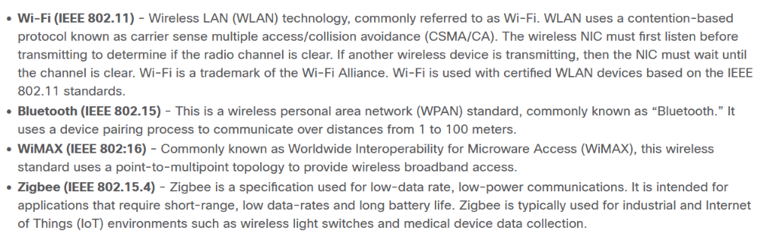
TYPES OF WIRELESS MEDIA

Slide 20
THANK YOU FOR YOUR ATTENTION

