Slide 1
CCNA UNIT 5
NUMBER SYSTEMS
FRANK SCHNEEMANN, SWC

Slide 2
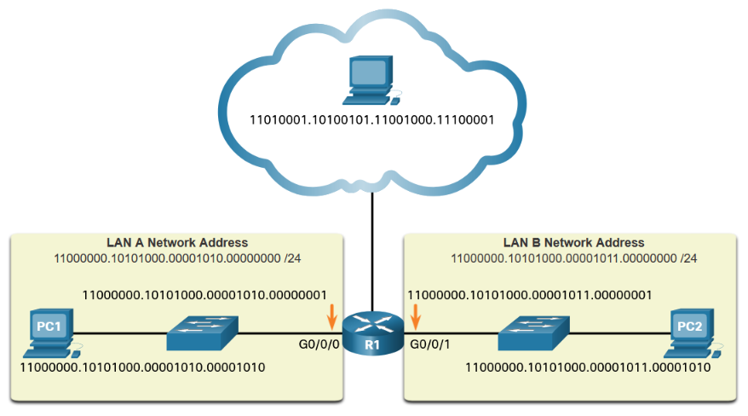
128 | 64 | 32 | 16 | 8 | 4 | 2 | 1
Binary and IPv4 Addresses
ONES AND ZEROS REPRESENT PULSES OF ELECTRICITY

Slide 3
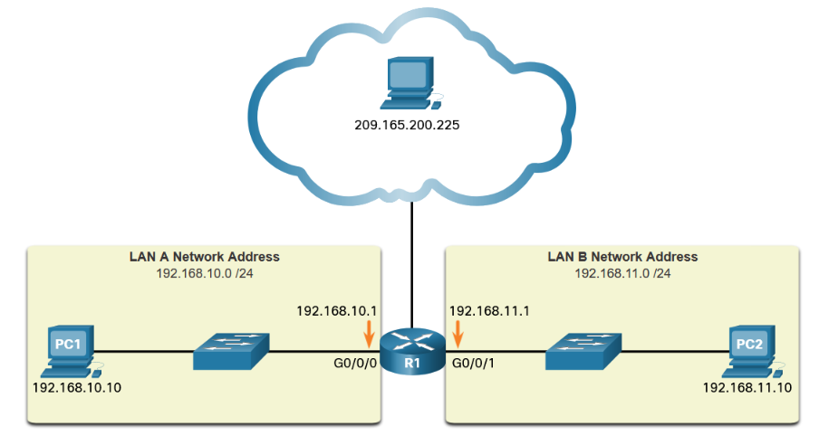
128 | 64 | 32 | 16 | 8 | 4 | 2 | 1
WATCH THE VIDEO ON CONVERTING BINARY TO DECIMAL
CONVERTING ONES AND ZEROS INTO DECIMALS

Slide 4
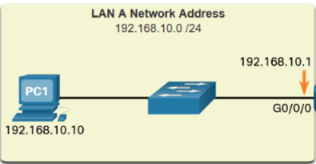
128 | 64 | 32 | 16 | 8 | 4 | 2 | 1
1 | 1
1 |  | 1 |  | 1
 |  |  |  | 1 |  | 1
 |  |  |  |  |  |  | 1
192
168
10
1
CONVERTING BINARY TO DECIMAL

Slide 5
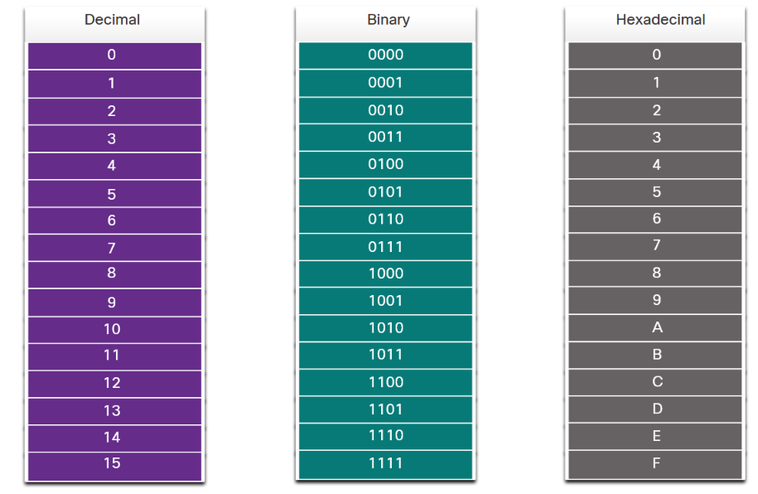
HEXADECIMAL
8 4 2 1
BASE 16
BASE 10
BASE 2

Slide 6
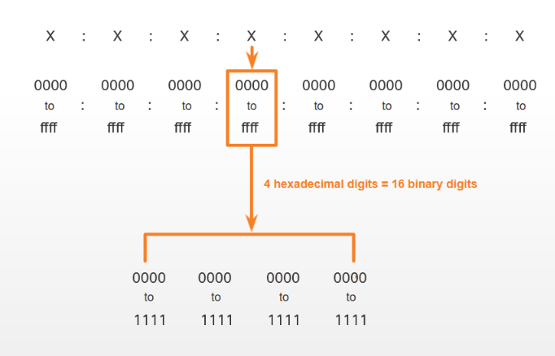
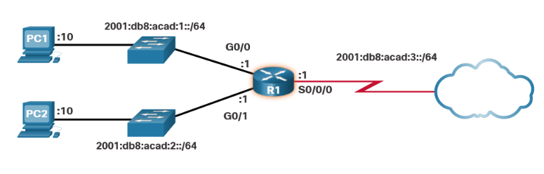
IPV6 USES HEXADECIMAL NUMBERS
The sample topology in the figure displays IPv6 hexadecimal addresses.
/64 IS LIKE THE SUBNET MASK
SHOWS THE NETWORK PART OF THE ADDRESS

Slide 7
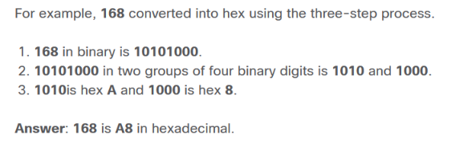
8 | 4 | 2 | 1
This example provides the steps for converting D2 to decimal.
D2 in 4-bit binary strings is 1101 and 0010.
1101 and 0010 is 11010010 in an 8-bit grouping.
11010010 in binary is equivalent to 210 in decimal.
Answer: D2 in hexadecimal is 210 in decima

Slide 8
THANK YOU FOR YOUR ATTENTION

