Slide 1
CCNA UNIT 6
DATALINK LAYER
FRANK SCHNEEMANN, SWC

Slide 2
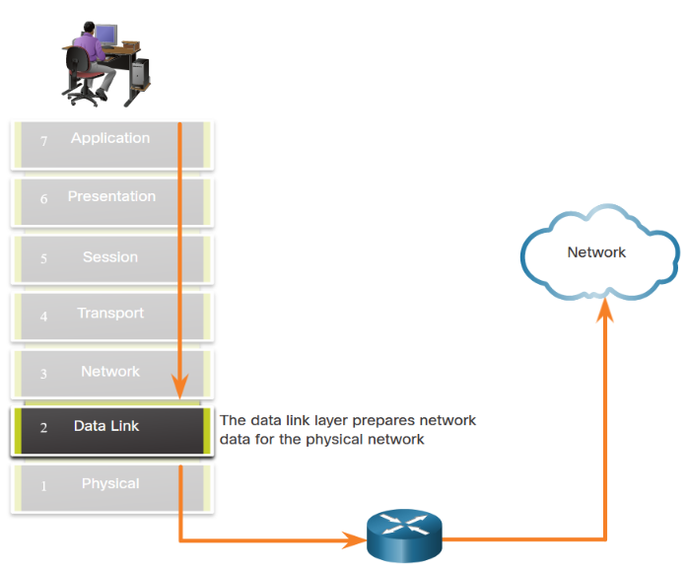
Enables upper layers to access the media.
Accepts data, usually Layer 3 packets (i.e., IPv4 or IPv6), and encapsulates them into Layer 2 frames.
Controls how data is placed and received on the media.
Exchanges frames between endpoints over the network media.
Receives encapsulated data, usually Layer 3 packets, and directs them to the proper upper-layer protocol.
Performs error detection and rejects any corrupt frame.

Slide 3
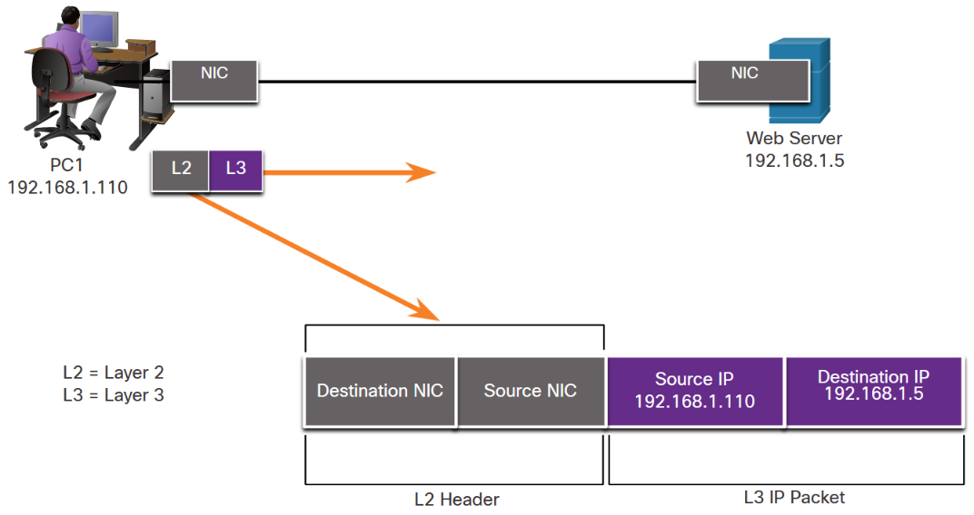
The figure displays an example of how the data link layer adds Layer 2 Ethernet destination and source NIC information to a Layer 3 packet. It would then convert this information to a format supported by the physical layer (i.e., Layer 1).

Slide 5
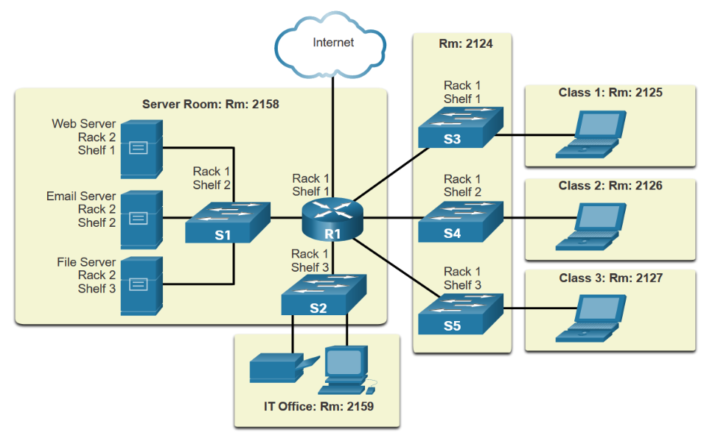
PHYSICAL TOPOLOGY

Slide 6
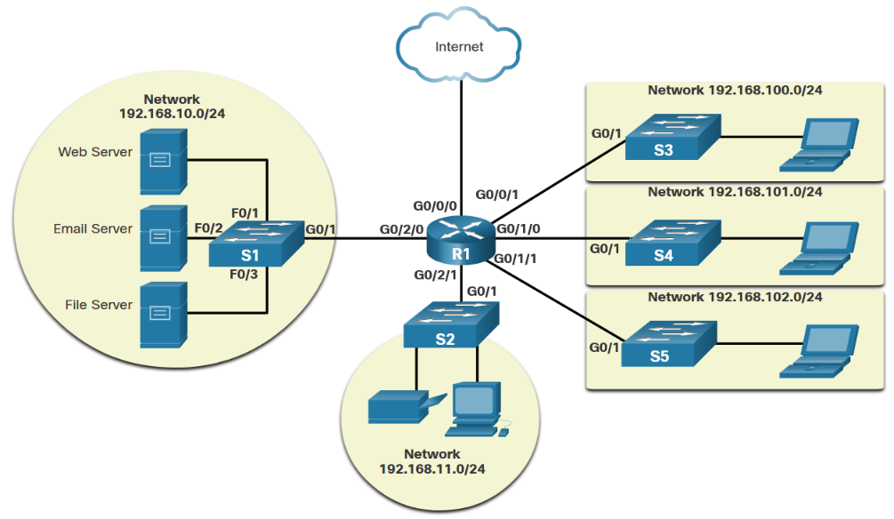
LOGICAL TOPOLOGY

Slide 7
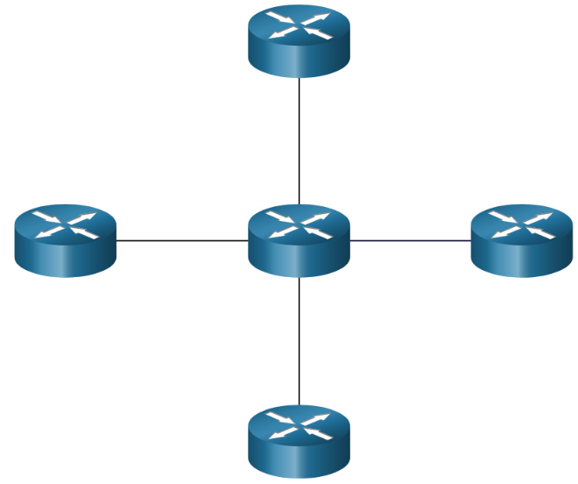
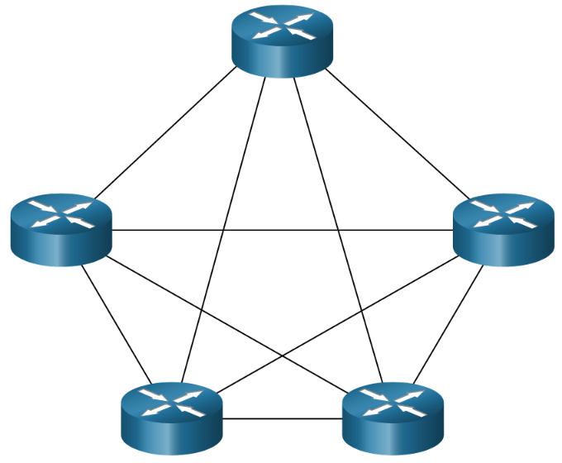
TOPOLOGIES
POINT TO POINT
MESH
HUB AND SPOKE

Slide 8
A point-to-point connection over Ethernet requires the device to determine if the incoming frame is destined for this node.
A source and destination node may be indirectly connected to each other over some geographical distance using multiple intermediary devices. However, the use of physical devices in the network does not affect the logical topology, as illustrated in the figure.

Slide 9
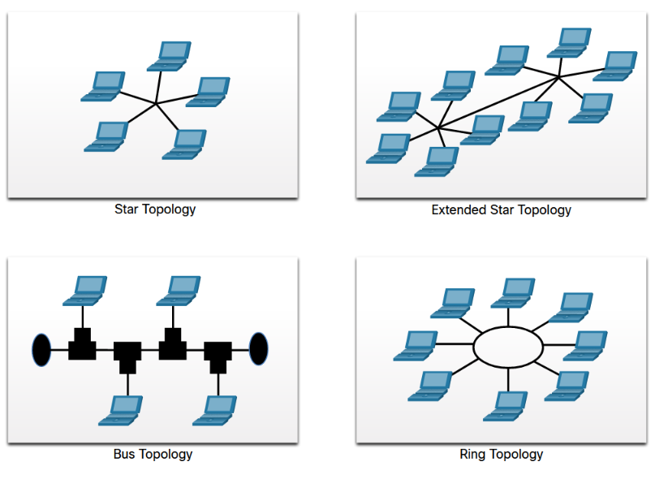
PHYSICAL TOPOLOGIES

Slide 10
HALF DUPLEXe
FULL DUPLEX

Slide 11
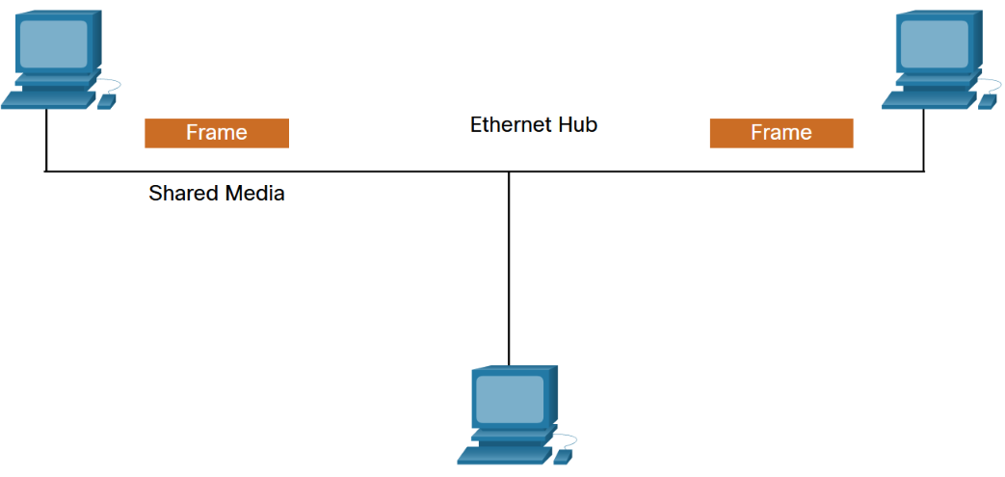
Contention-based access
In contention-based multiaccess networks, all nodes are operating in half-duplex, competing for the use of the medium. However, only one device can send at a time. Examples of contention-based access methods include the following:
Carrier sense multiple access with collision detection (CSMA/CD) used on legacy bus-topology Ethernet LANs
Carrier sense multiple access with collision avoidance (CSMA/CA) used on Wireless LANs

Slide 12
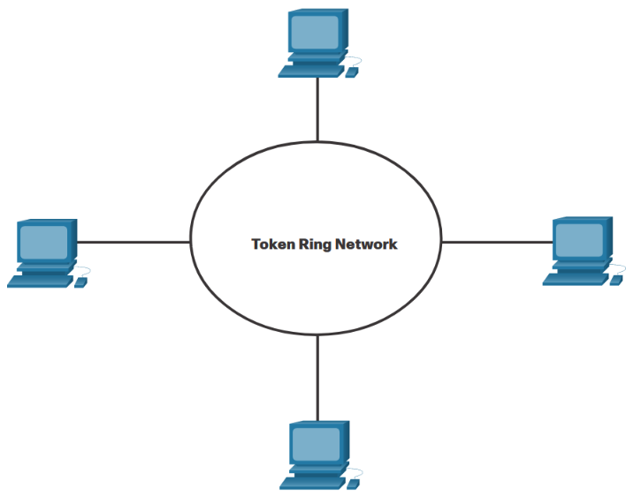
Controlled access
In a controlled-based multiaccess network, each node has its own time to use the medium. These deterministic types of legacy networks are inefficient because a device must wait its turn to access the medium. Examples of multiaccess networks that use controlled access include the following:
Legacy Token Ring
Legacy ARCNET

Slide 13
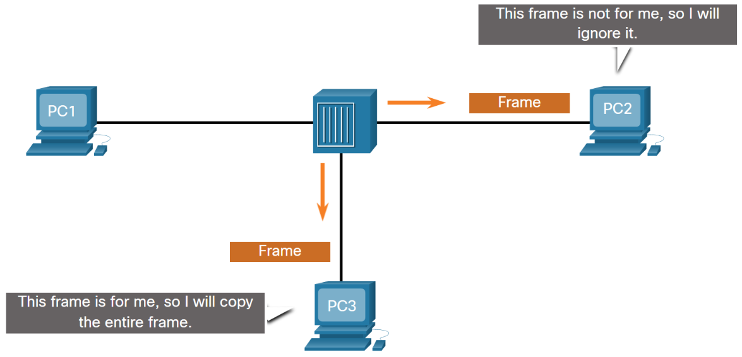
All devices attached to the hub will receive the frame. However, because the frame has a destination data link address for PC3, only that device will accept and copy in the entire frame. All other device NICs will ignore the frame, as shown in the figure.
Contention-Based Access - CSMA/CD
Wireless LAN (uses CSMA/CA)
Legacy bus-topology Ethernet LAN (uses CSMA/CD)
Legacy Ethernet LAN using a hub (uses CSMA/CD)

Slide 14
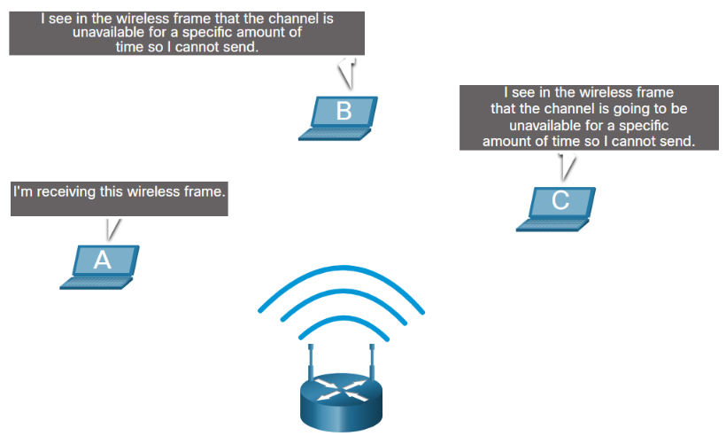
Contention-Based Access - CSMA/CA
In the figure, if host A is receiving a wireless frame from the access point, hosts B, and C will also see the frame and how long the medium will be unavailable.

Slide 15
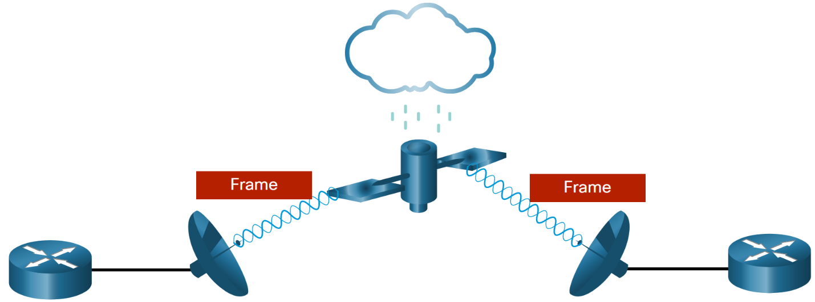
The data link protocol is responsible for NIC-to-NIC communications within the same network. Although there are many different data link layer protocols that describe data link layer frames, each frame type has three basic parts:
Header
Data
Trailer
The Frame

Slide 16
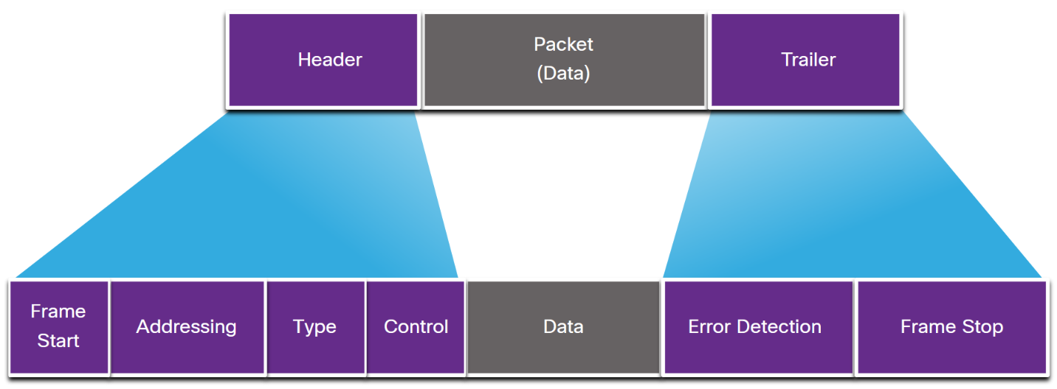
Frame Fields
The generic frame fields are shown in the figure. Not all protocols include all these fields. The standards for a specific data link protocol define the actual frame format.

Slide 17
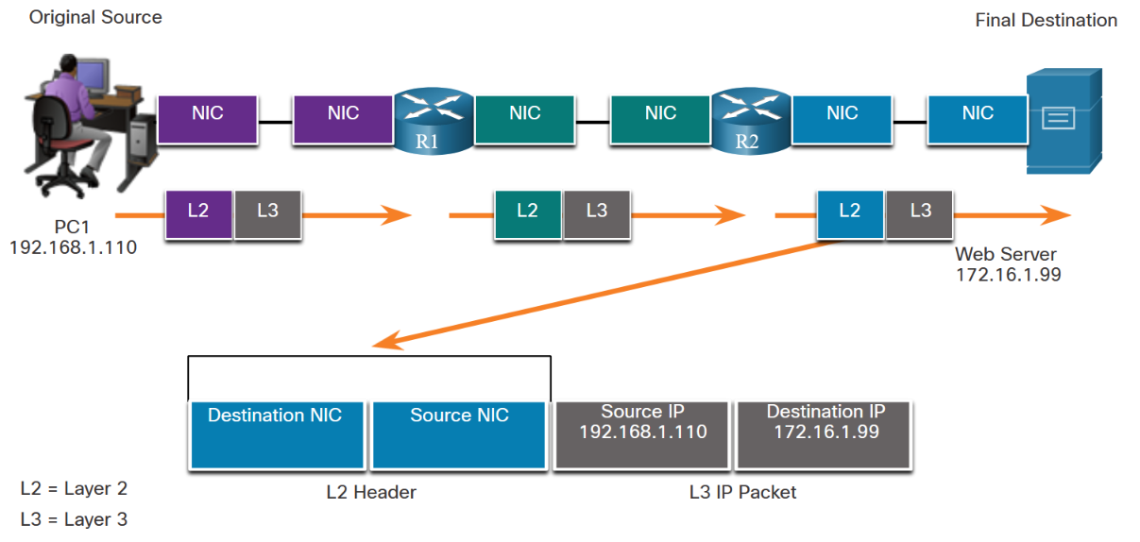
Layer 2 Addresses
R2 encapsulates the Layer 3 IP packet in a new Layer 2 frame. In the frame header, R2 adds its Layer 2 address as the source and the Layer 2 address for the server as the destination

Slide 18
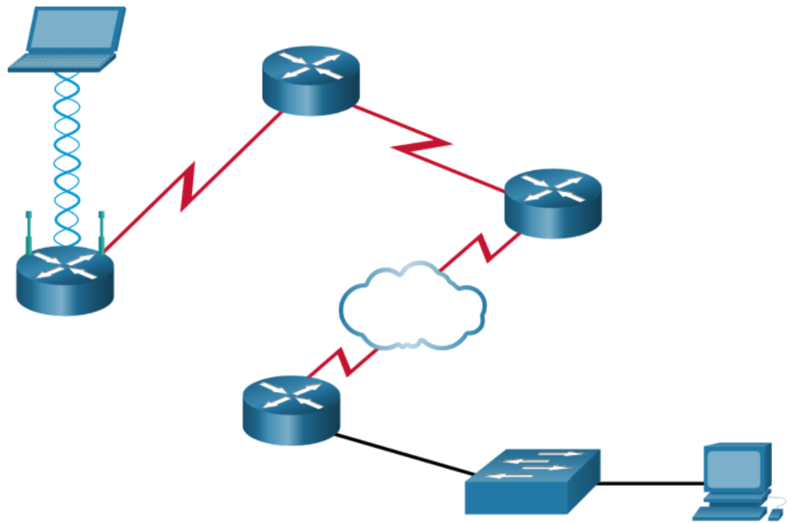
Some of the common WAN protocols over the years have included:
Point-to-Point Protocol (PPP)
High-Level Data Link Control (HDLC)
Frame Relay
Asynchronous Transfer Mode (ATM)
X.25
These Layer 2 protocols are now being replaced in the WAN by Ethernet.
LAN and WAN Frames

Slide 19
THANK YOU FOR YOUR ATTENTION

