Slide 1
CCNA UNIT 7
Ethernet Encapsulation
FRANK SCHNEEMANN, SWCC

Slide 2
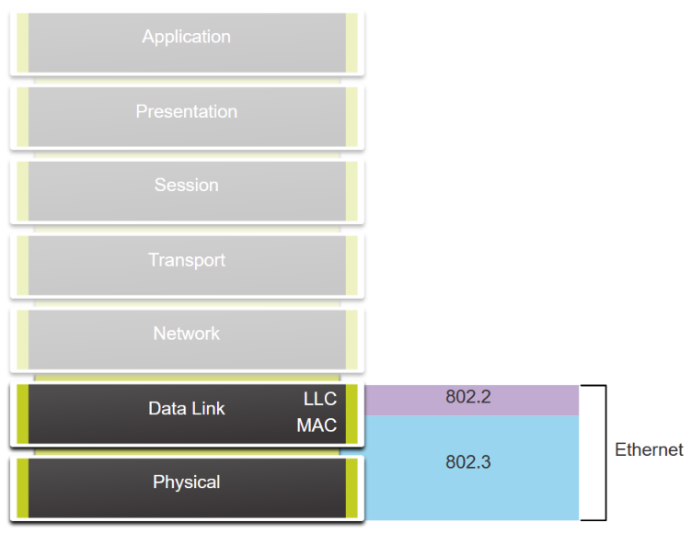
Ethernet and the OSI Model

Slide 3
Ethernet Frame Fields

Slide 4
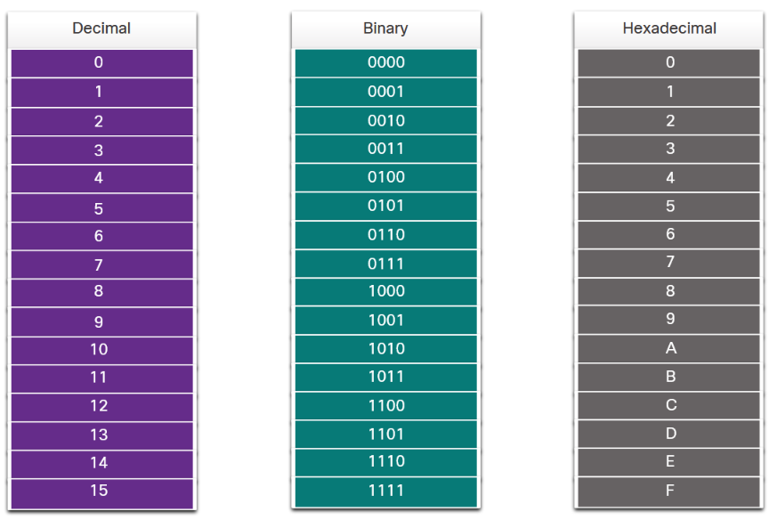
Decimal and Binary Equivalents of 0 to F Hexadecimal
8 4 2 1
0101 = 5 5
1101 = 13 D
1111 = 15 F

Slide 5
Ethernet MAC Address

Slide 6
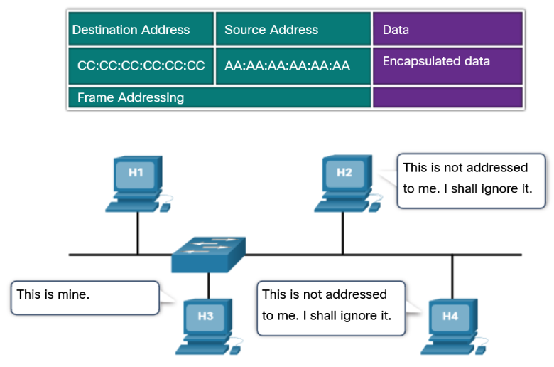
Frame Processing
ETHERNET HEADER

Slide 7
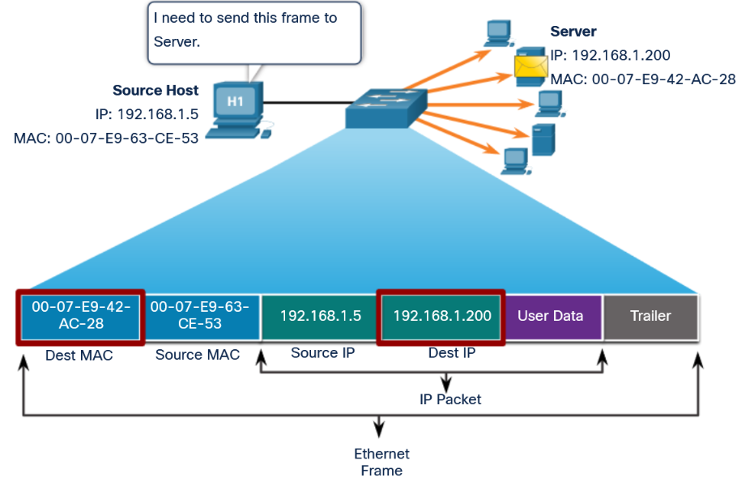
Unicast MAC Address

Slide 8
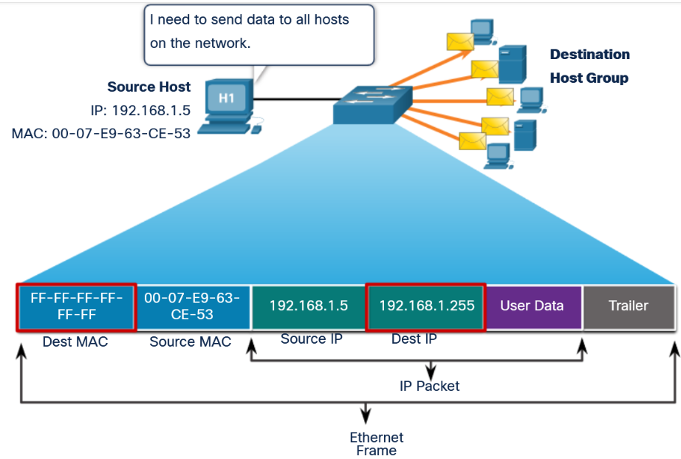
Broadcast MAC Address

Slide 9
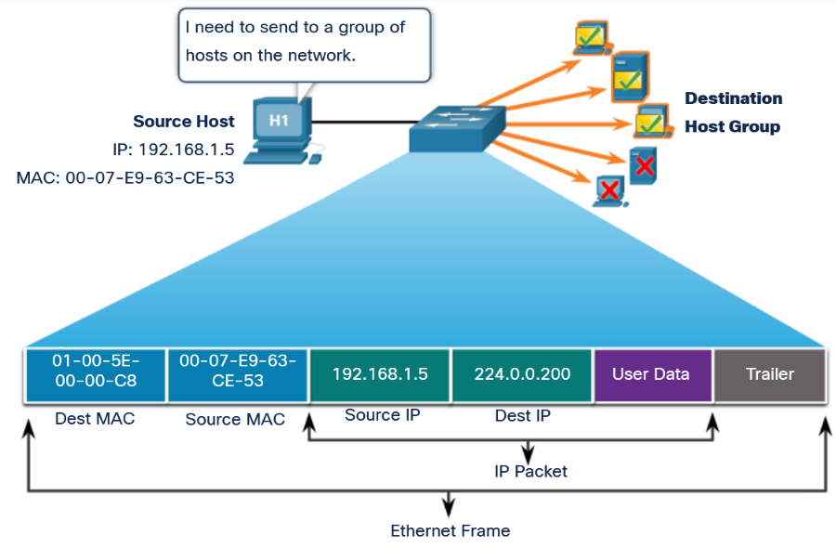
Multicast MAC Address

Slide 10
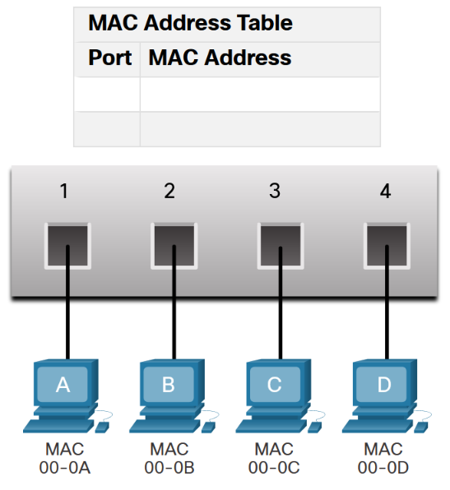
Switch Fundamentals
An Ethernet switch examines its MAC address table to make a forwarding decision for each frame, unlike legacy Ethernet hubs that repeat bits out all ports except the incoming port. In the figure, the four-port switch was just powered on. The table shows the MAC Address Table which has not yet learned the MAC addresses for the four attached PCs.

Slide 11
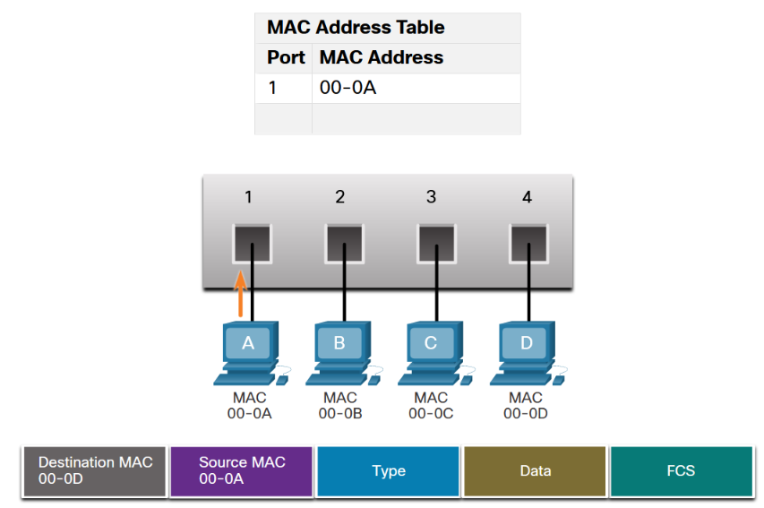
Switch Learning and Forwarding
LEARNING

Slide 12
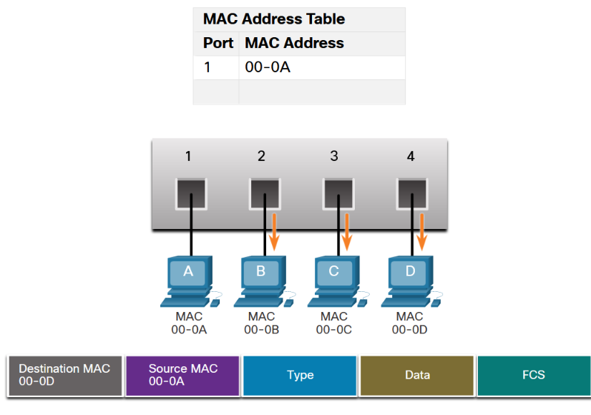
FORWORDING
As shown in the figure, the switch does not have the destination MAC address in its table for PC-D, so it sends the frame out all ports except port 1.
Note: If the destination MAC address is a broadcast or a multicast, the frame is also flooded out all ports except the incoming port.
The figure shows four hosts, A - D, are connected to a switch at ports 1 - 4. A frame has a destination MAC of 00-0D and a source MAC of 00-0A. The only entry in the MAC address table maps port 1 to MAC address 00-0A. The frame is forwarded out ports 2, 3, and 4.

