Slide 1
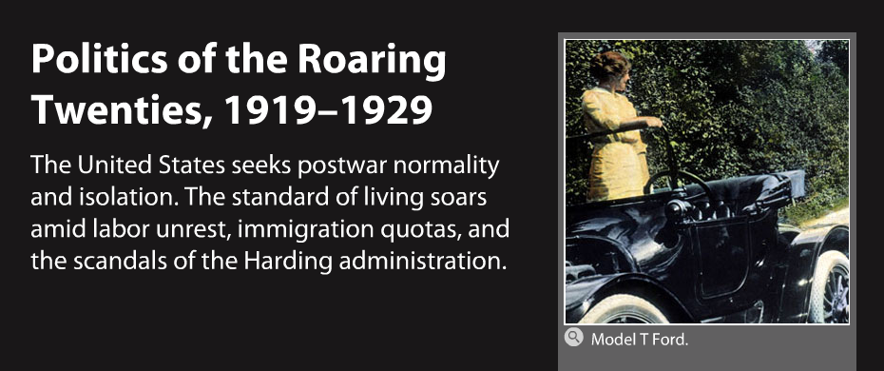
HIS CH-12 POLITICS IN THE 20s

Slide 2

HIS CH-12-1 POSTWAR ISSUES

Slide 3
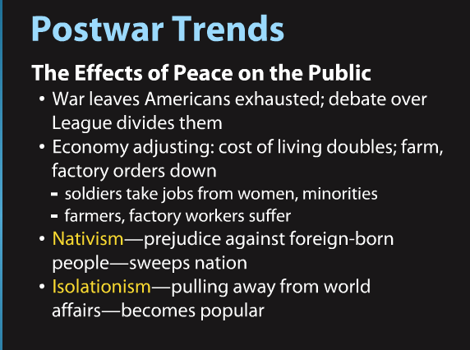
HIS CH-12-1 POSTWAR ISSUES

Slide 4
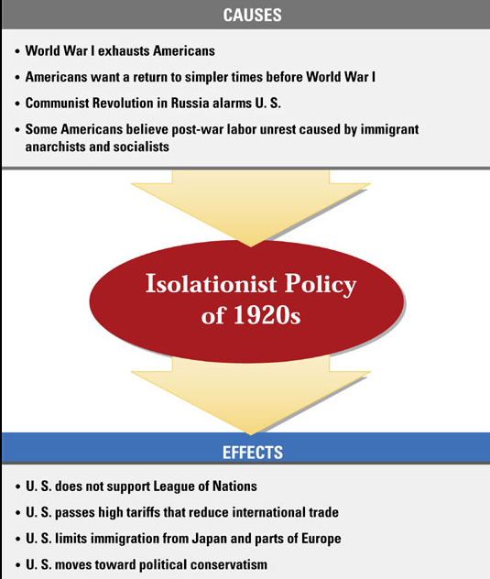
HIS CH-12-1 POSTWAR ISSUES

Slide 5
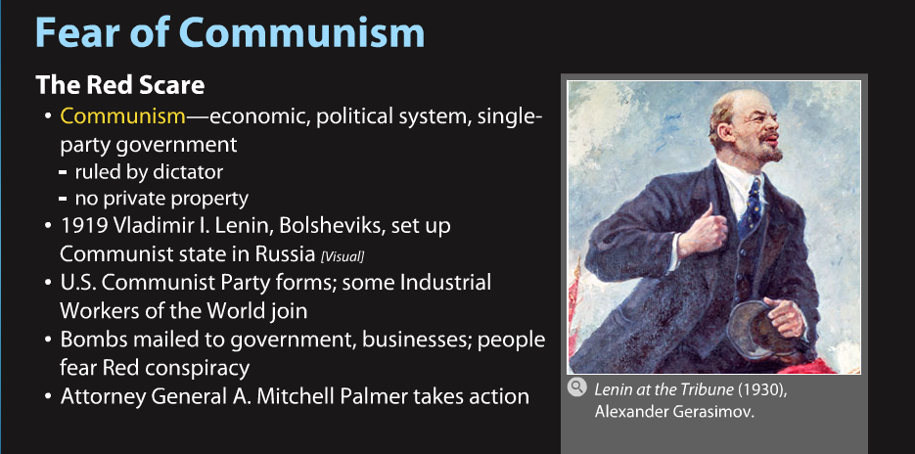
HIS CH-12-1 POSTWAR ISSUES

Slide 6

HIS CH-12-1 POSTWAR ISSUES

Slide 7
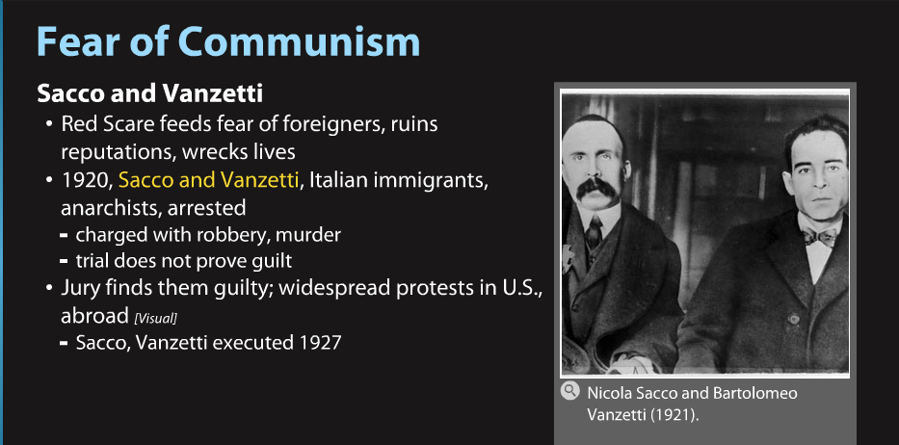
HIS CH-12-1 POSTWAR ISSUES

Slide 8
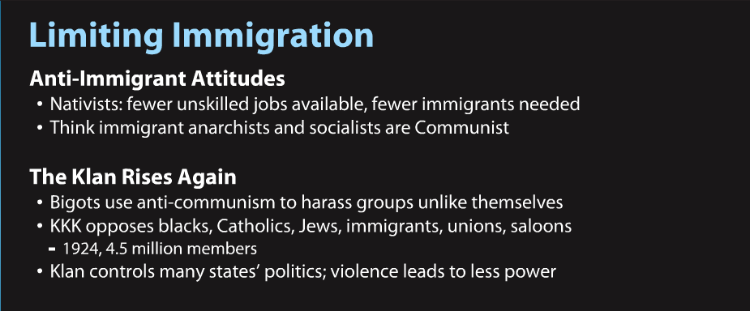
HIS CH-12-1 POSTWAR ISSUES

Slide 9
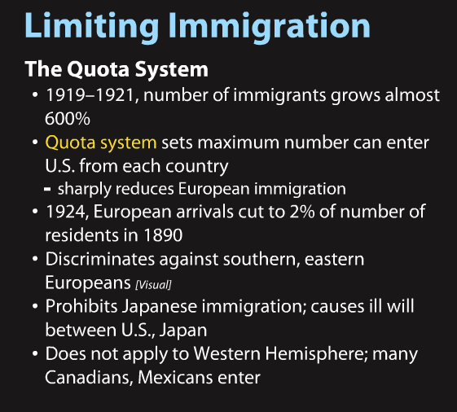
HIS CH-12-1 POSTWAR ISSUES

Slide 10
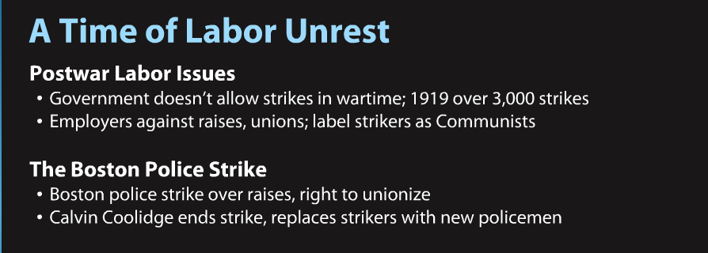
HIS CH-12-1 POSTWAR ISSUES

Slide 11
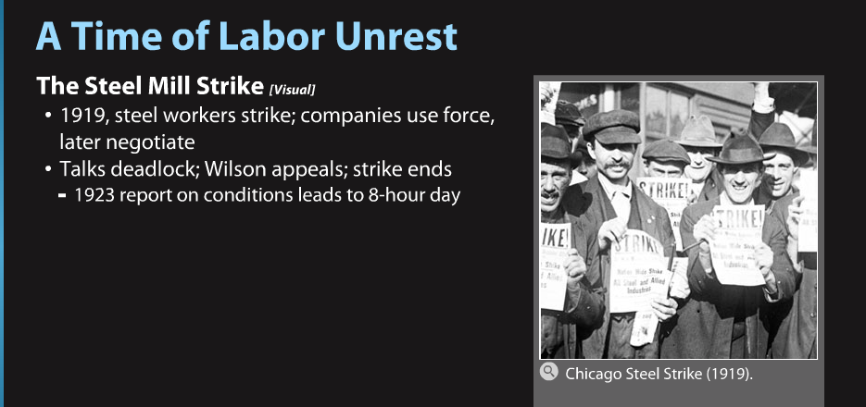
HIS CH-12-1 POSTWAR ISSUES

Slide 12
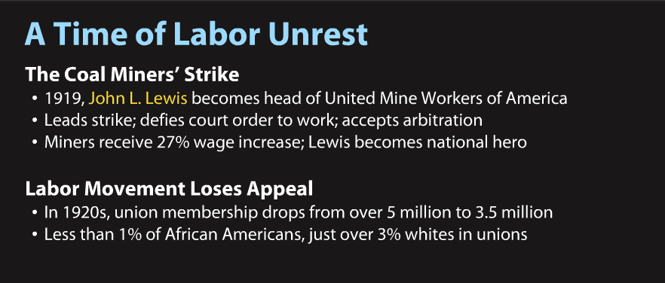
HIS CH-12-1 POSTWAR ISSUES

Slide 13

HIS CH-12-2 PRESIDENT HARDING

Slide 14
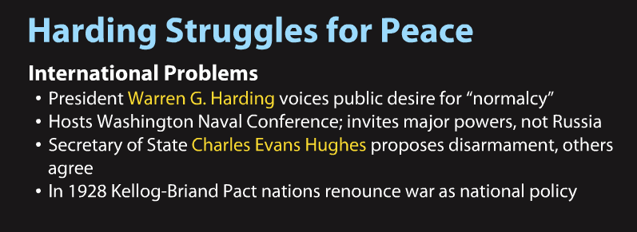
HIS CH-12-2 PRESIDENT HARDING

Slide 15
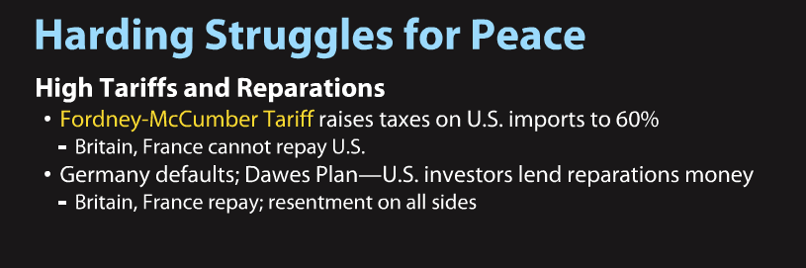
HIS CH-12-2 PRESIDENT HARDING

Slide 16

HIS CH-12-2 PRESIDENT HARDING

Slide 17
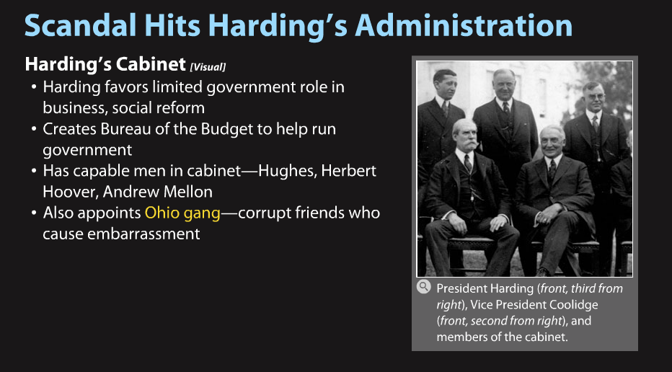
HIS CH-12-2 PRESIDENT HARDING

Slide 18

HIS CH-12-2 PRESIDENT HARDING

Slide 19
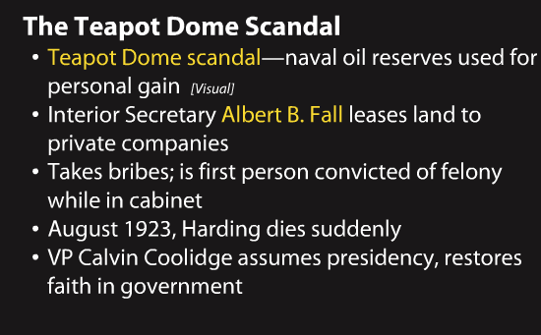
HIS CH-12-2 PRESIDENT HARDING

Slide 20

HIS CH-12-3 BUSINESS IN AMERICA

Slide 21

HIS CH-12-3 BUSINESS IN AMERICA

Slide 22
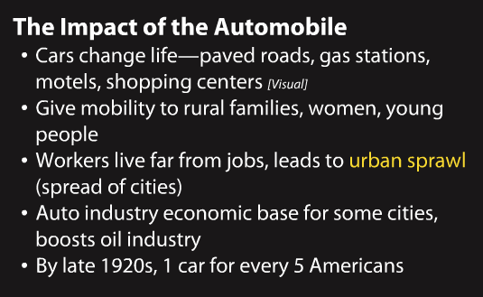
HIS CH-12-3 BUSINESS IN AMERICA

Slide 23
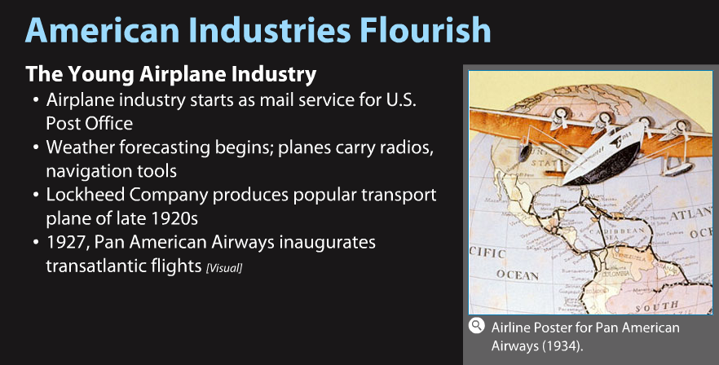
HIS CH-12-3 BUSINESS IN AMERICA

Slide 24
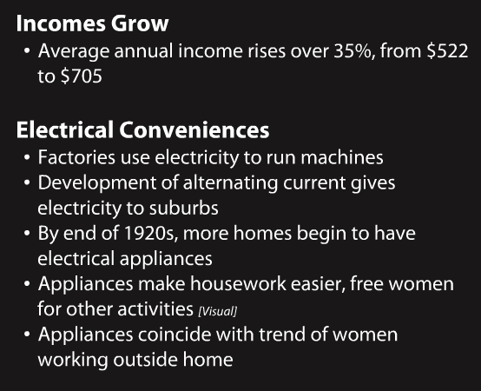
HIS CH-12-3 BUSINESS IN AMERICA

Slide 25
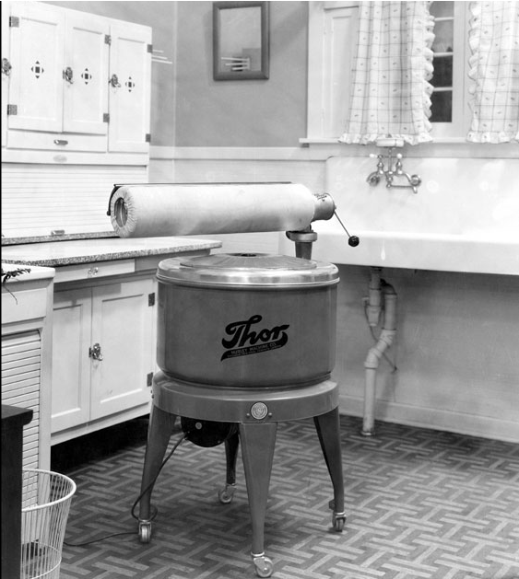
HIS CH-12-3 BUSINESS IN AMERICA

Slide 26

HIS CH-12-3 BUSINESS IN AMERICA

Slide 27
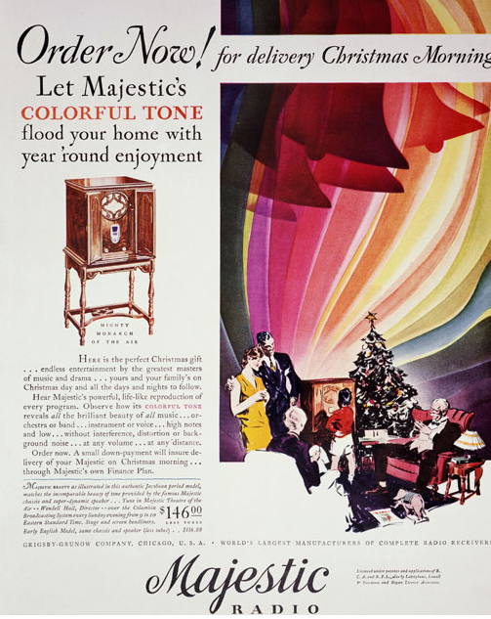
HIS CH-12-3 BUSINESS IN AMERICA

Slide 28

HIS CH-12-3 BUSINESS IN AMERICA

Slide 29
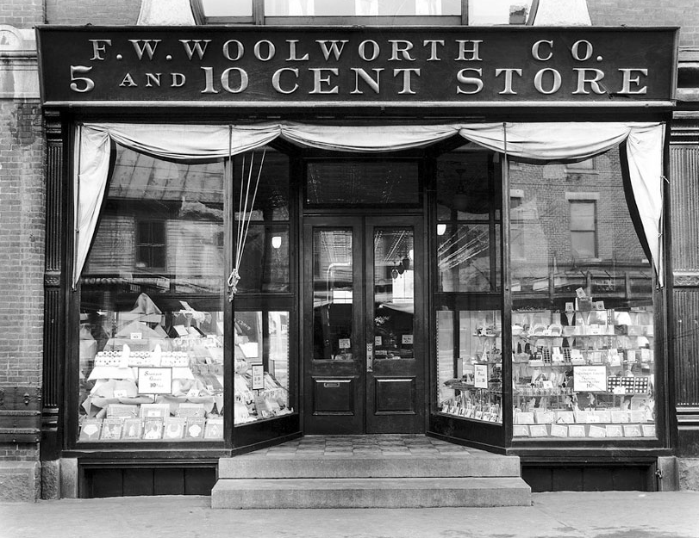
HIS CH-12-3 BUSINESS IN AMERICA

Slide 30
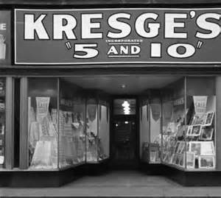
HIS CH-12-3 BUSINESS IN AMERICA

Slide 31
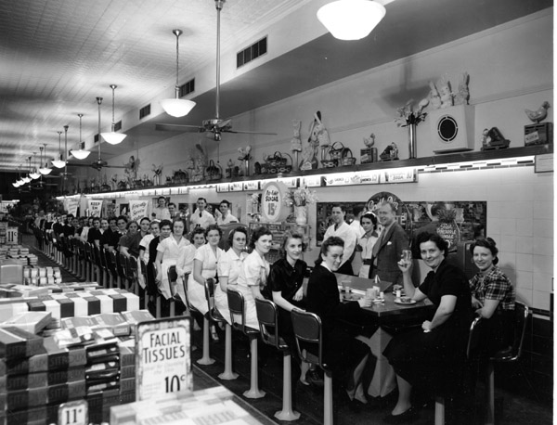
HIS CH-12-3 BUSINESS IN AMERICA

Slide 32

HIS CH-12-3 BUSINESS IN AMERICA

Slide 33

HIS CH-12-3 BUSINESS IN AMERICA

